Slide 1

DevOps CA2
TAN WEN TAO BRYAN
DAAA/FT/2B/01

Slide 2
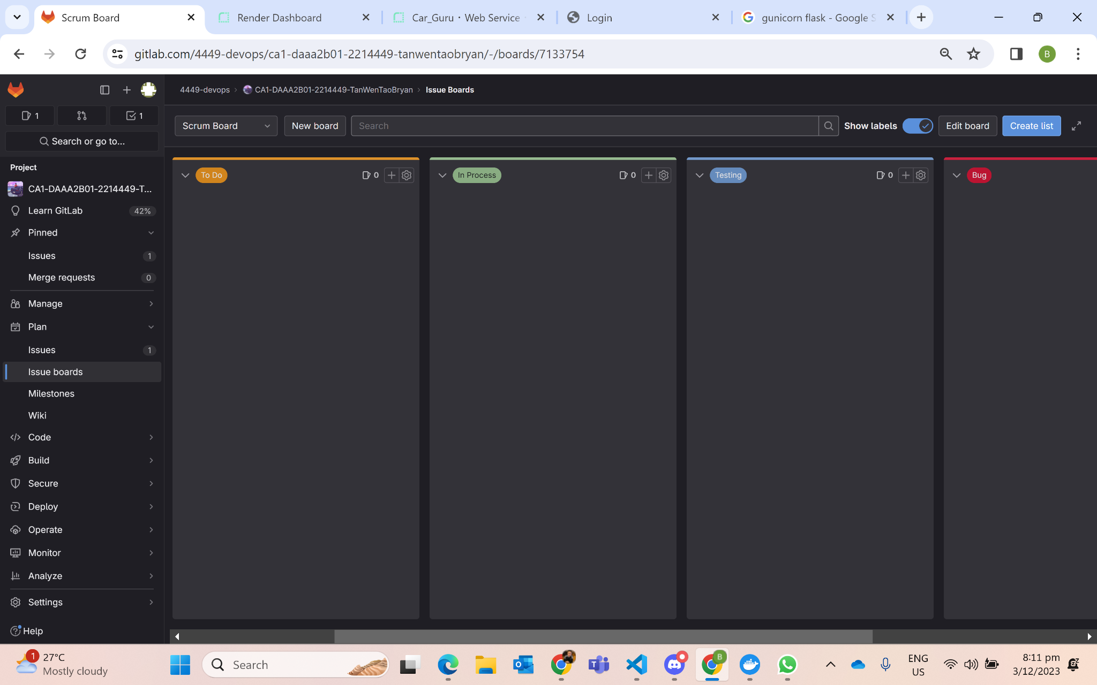
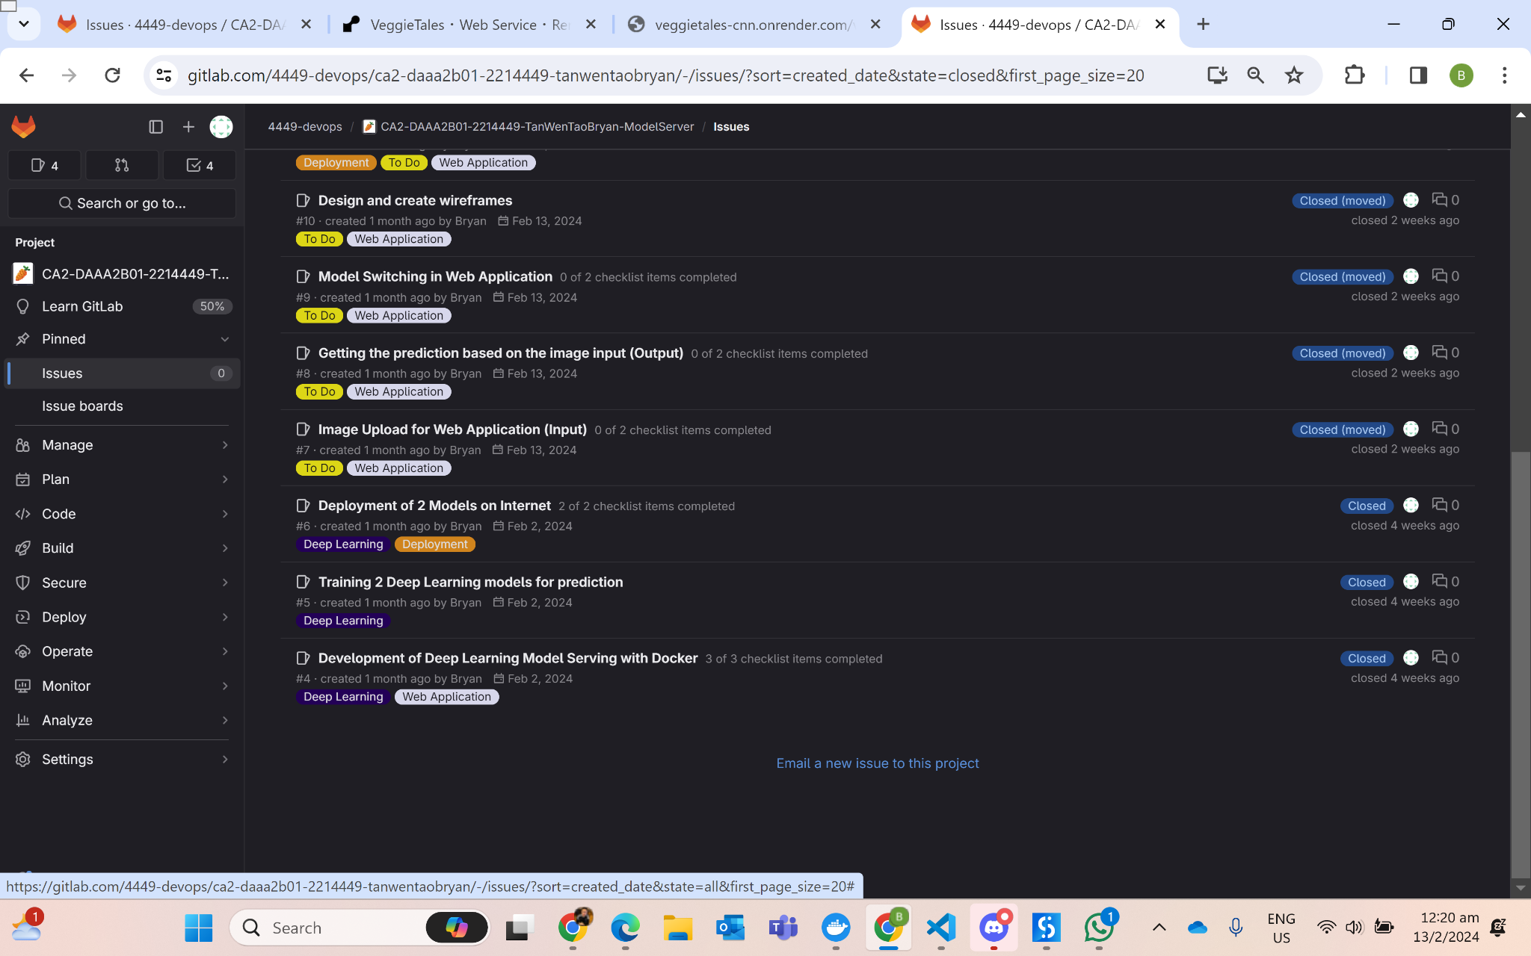
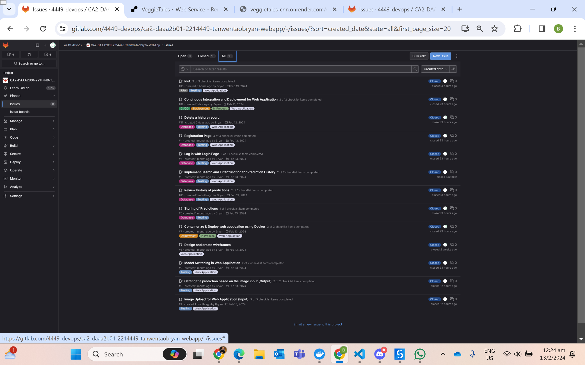
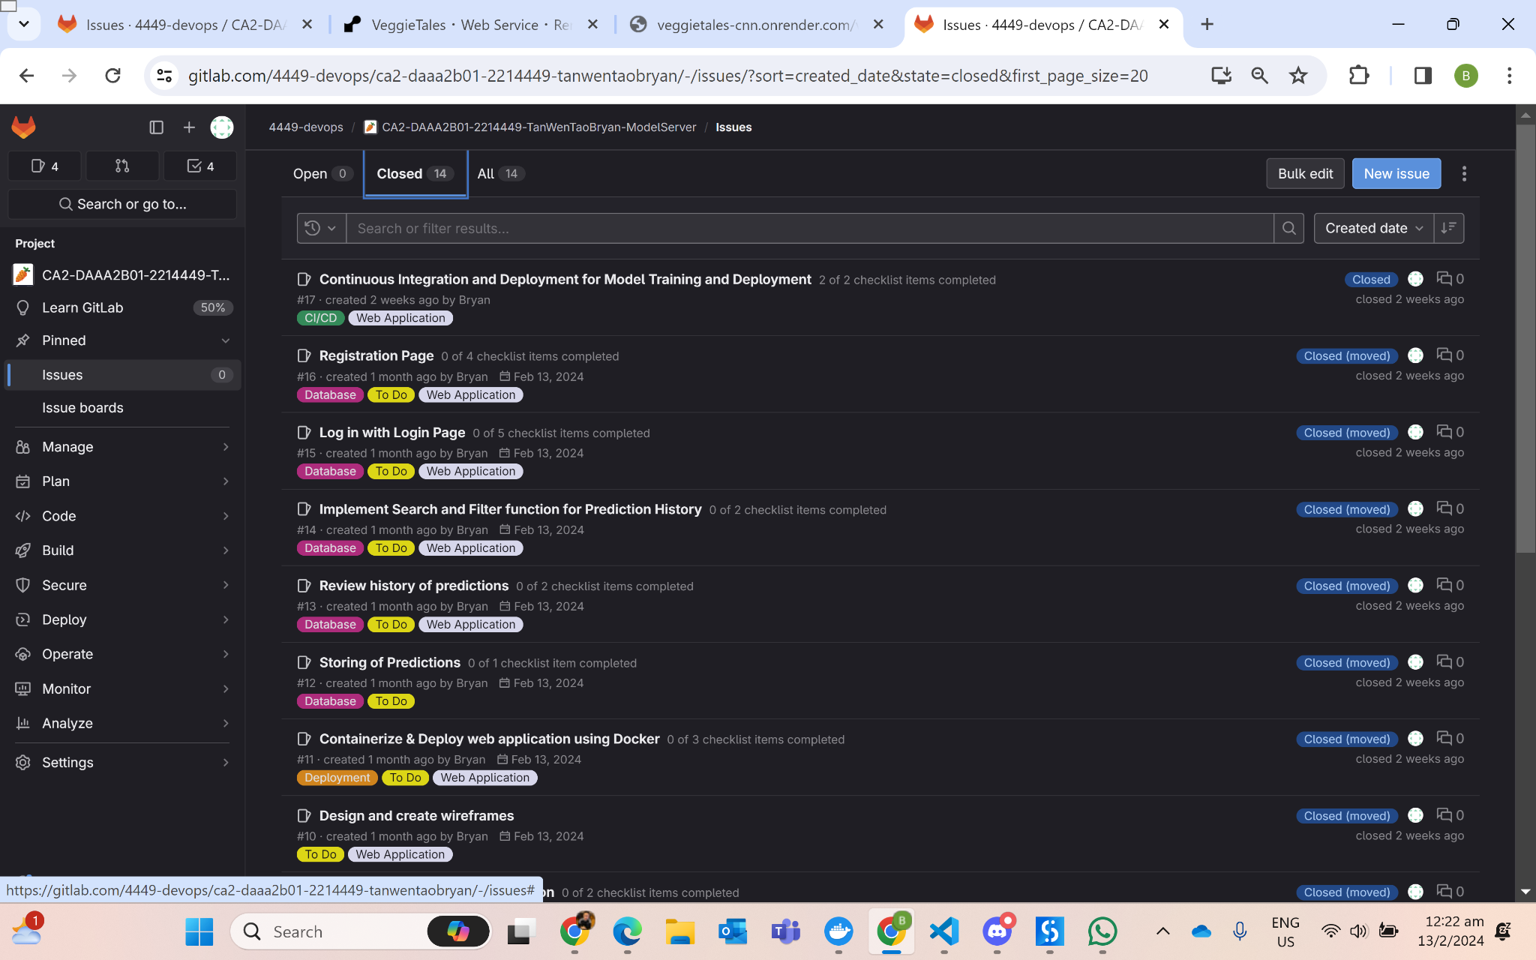
Issues & Labels
Model Server Repo
Web App Repo
Web App Repo

Slide 3







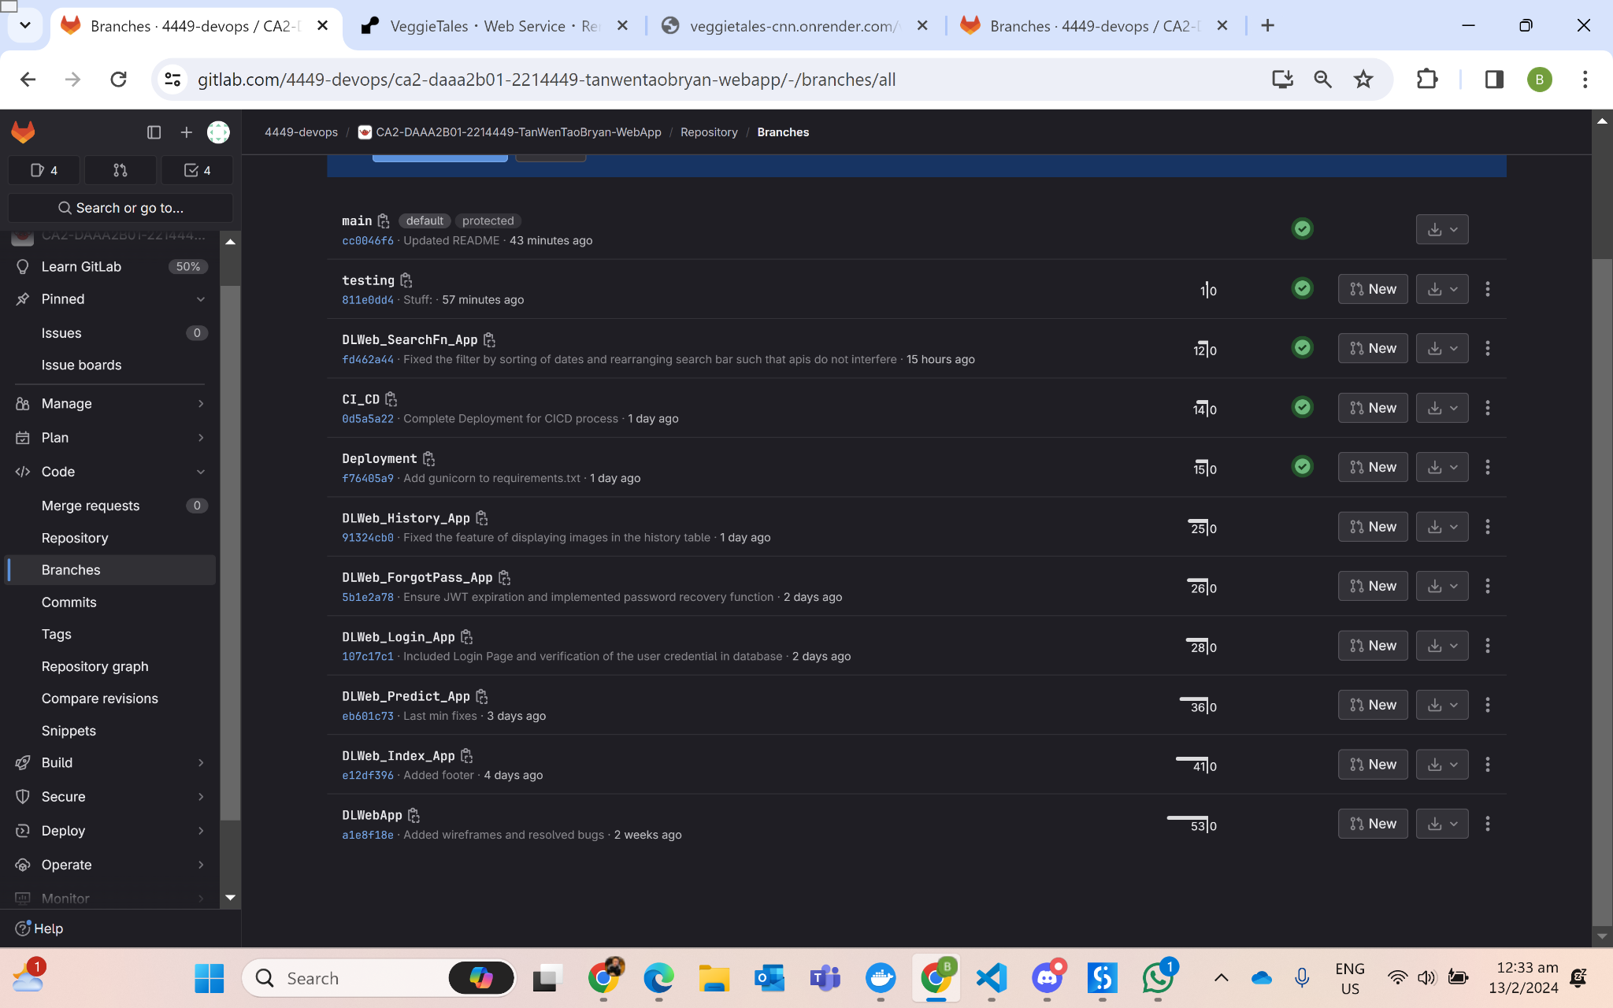
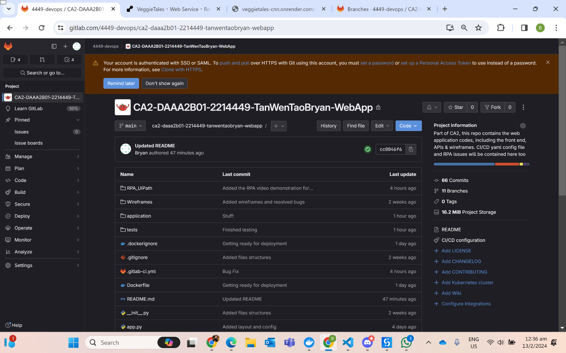
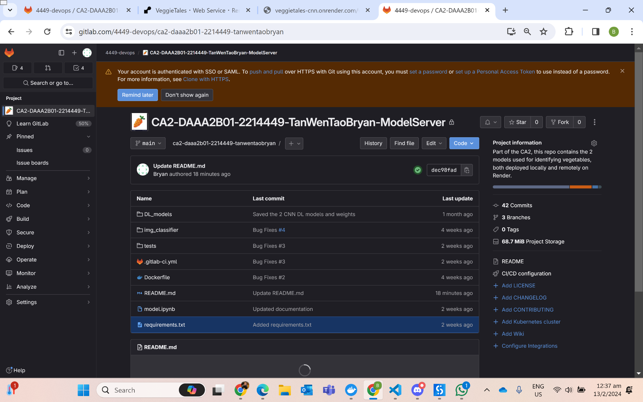
Git Branches & Commits
CI_CD
DLModel
DLWebApp
main
Deployment
testing
FrontEnd Features
(Each branched separately)

Slide 4
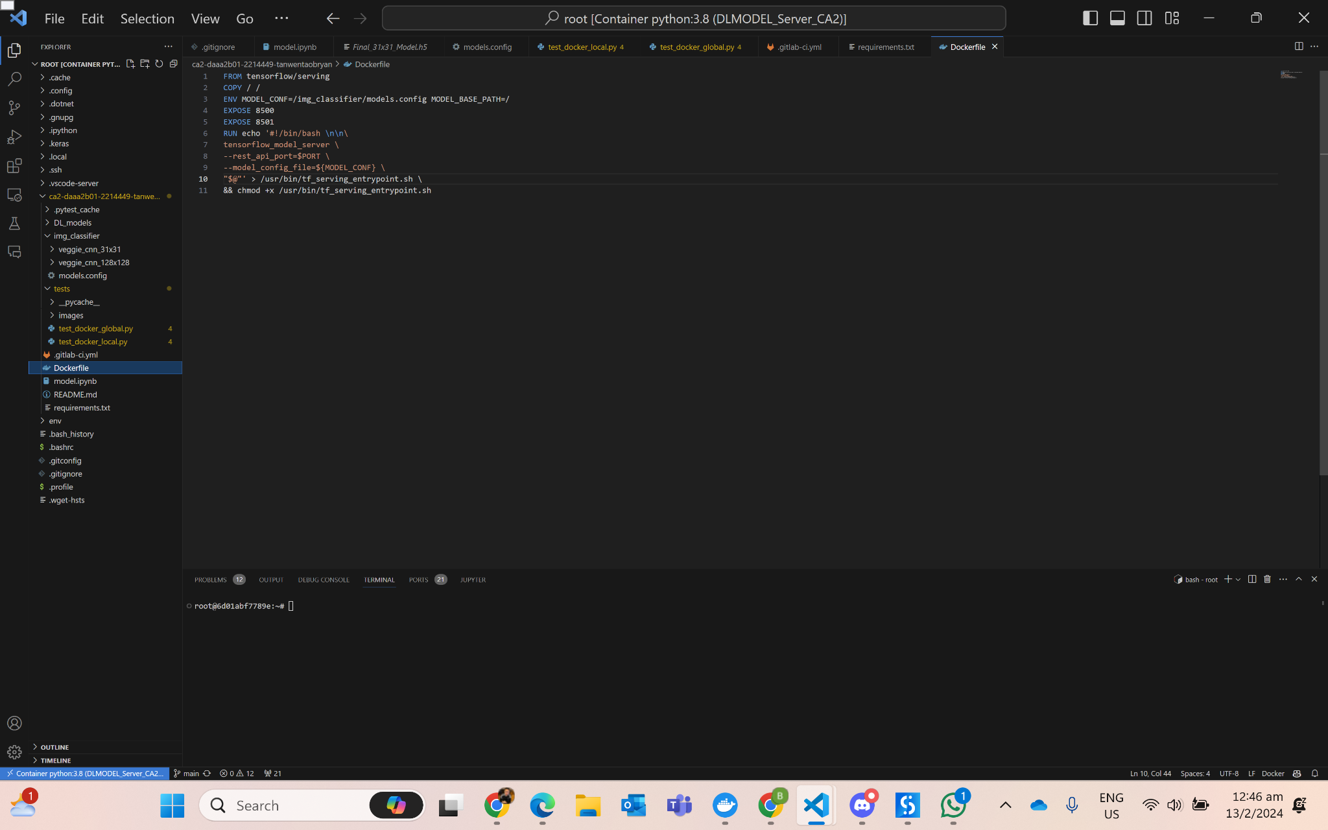
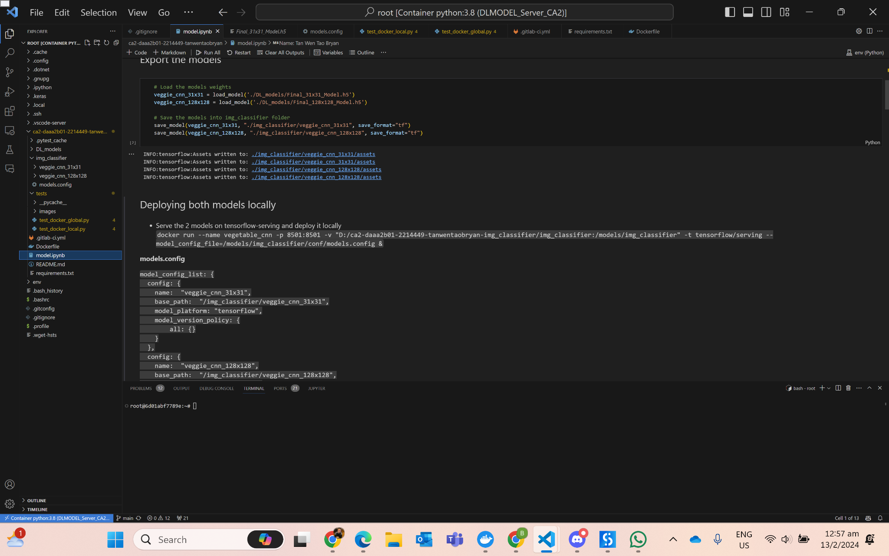
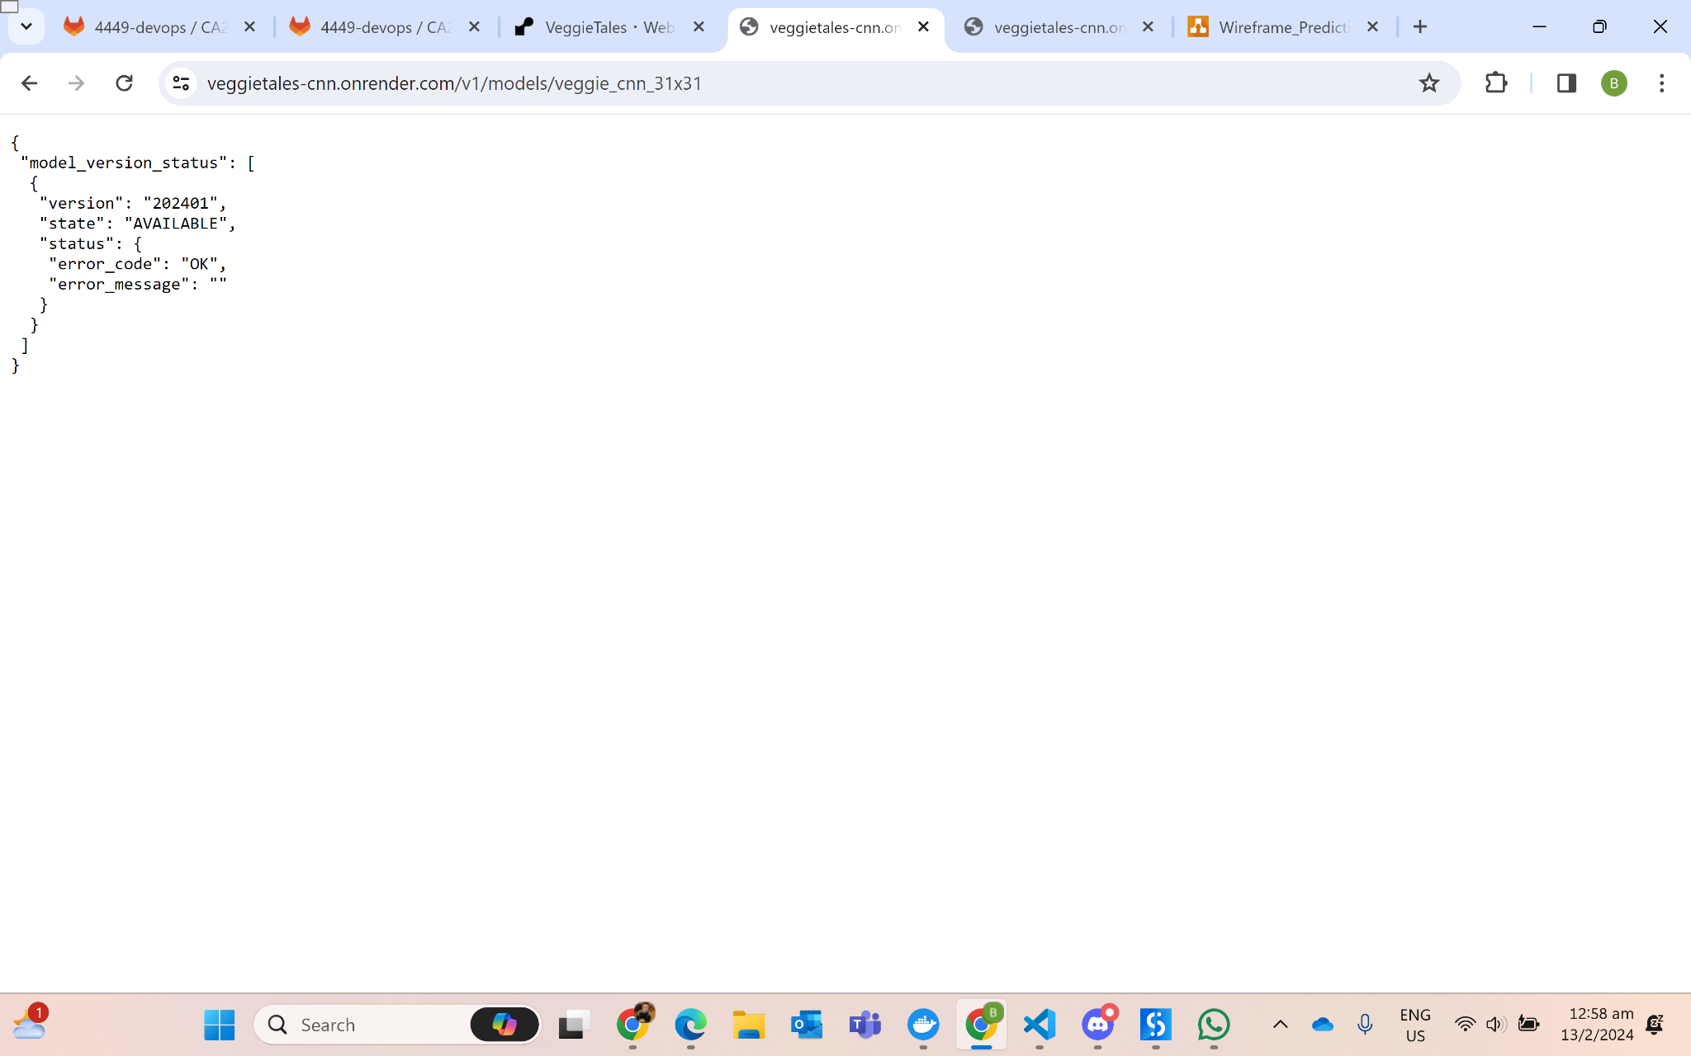
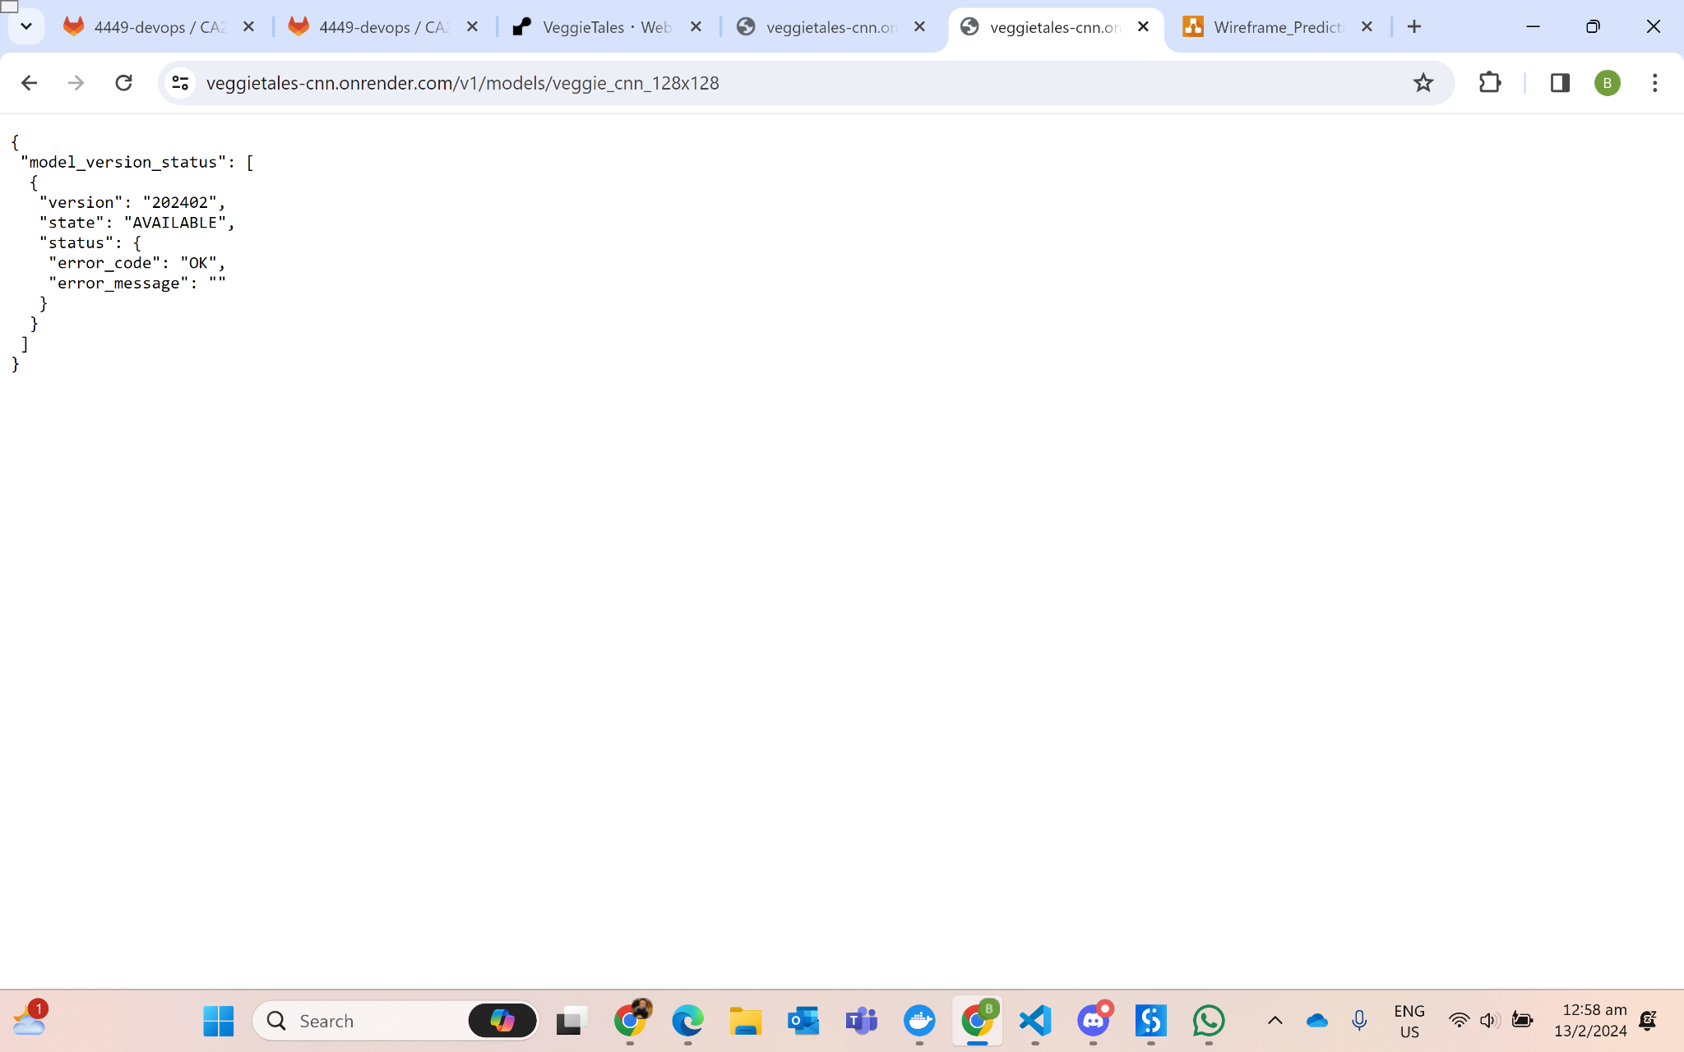
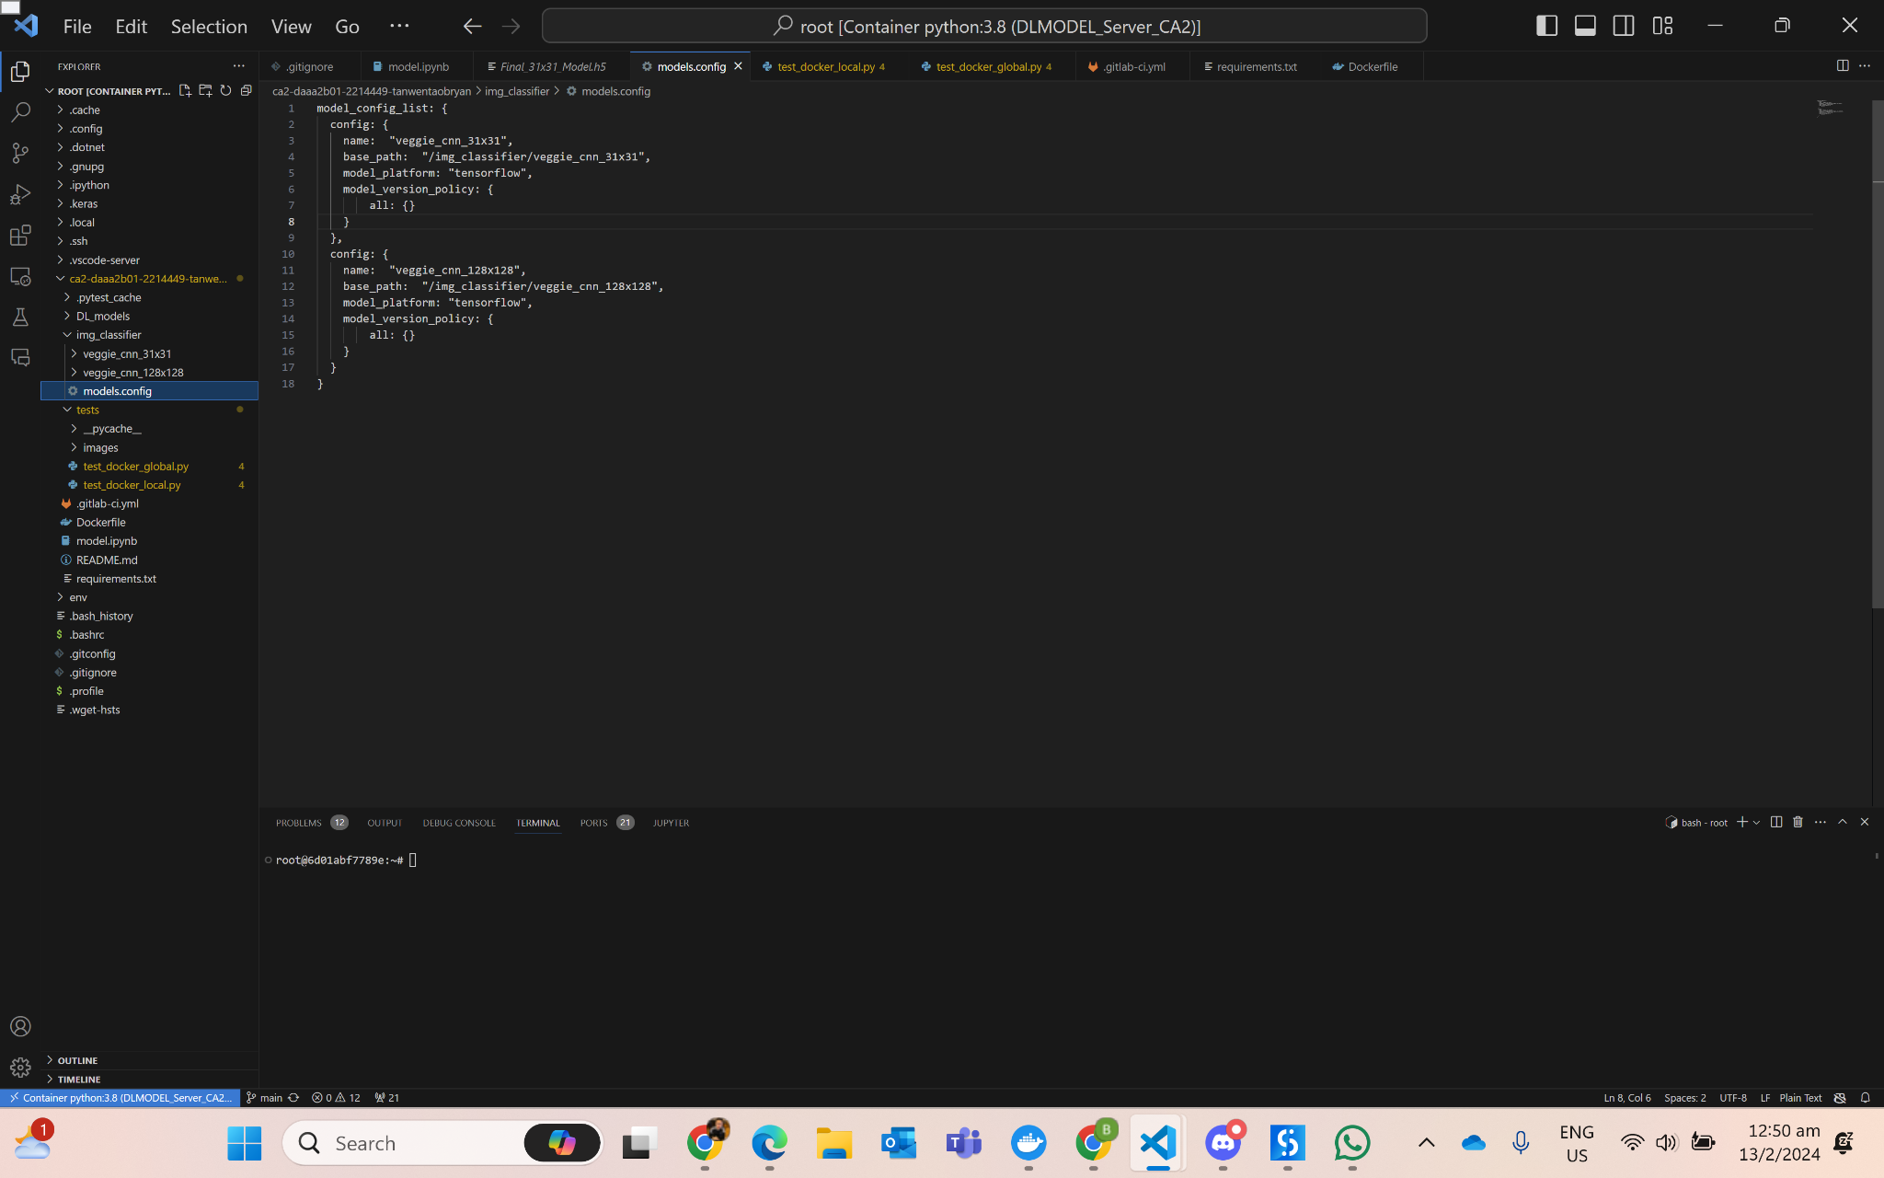

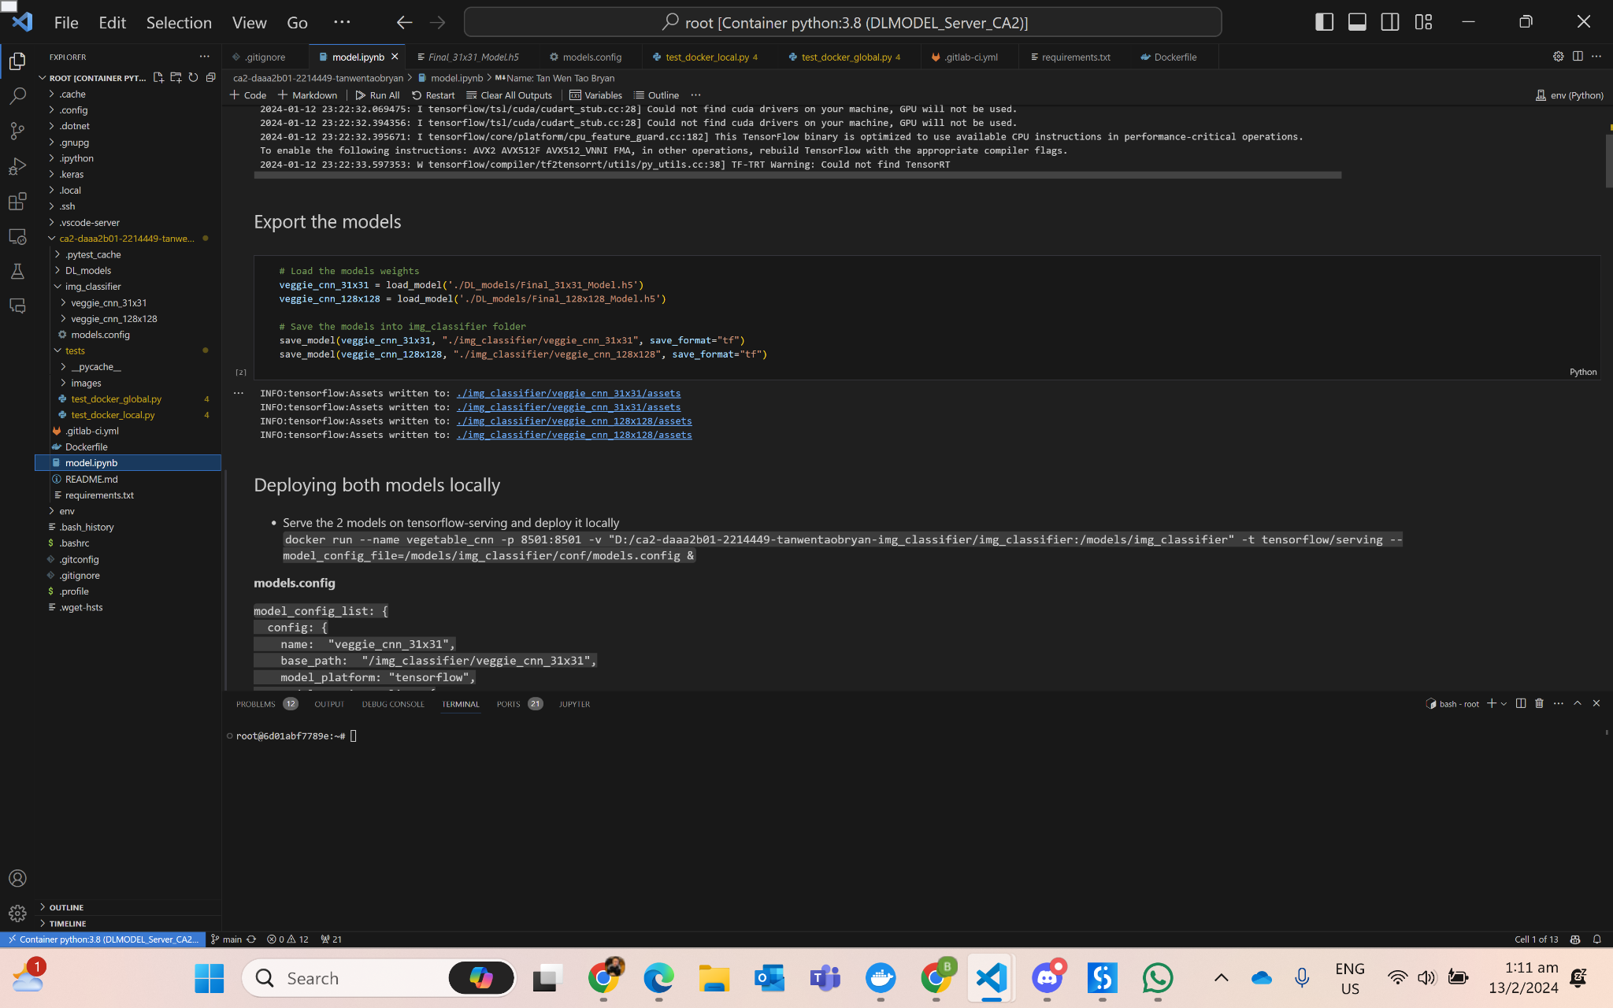
Model Deployment
Models Deployment:
https://veggietales-cnn.onrender.com/v1/models/veggie_cnn_31x31
https://veggietales-cnn.onrender.com/v1/models/veggie_cnn_128x128
Use of tensorflow serving to serve both models previously saved as tf format
Use of Docker to containerize both models and the dependencies through a config file
Deploy on Render for public access
Outputs of both deployed models

Slide 5
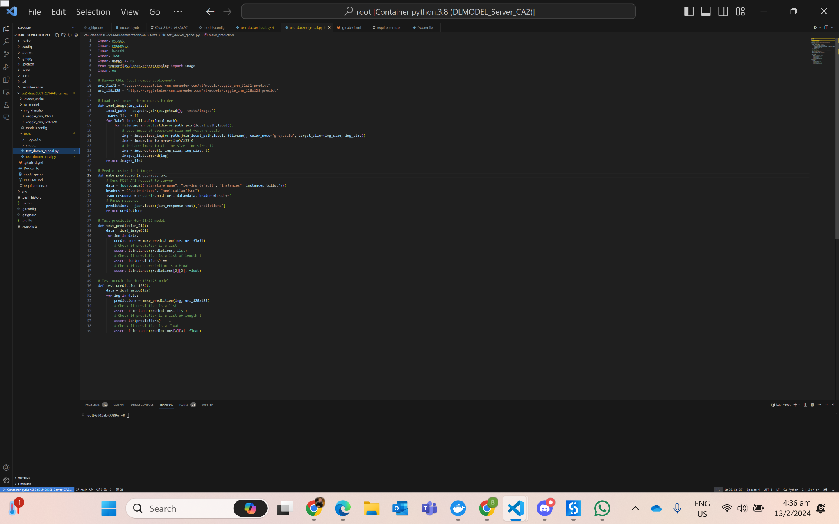
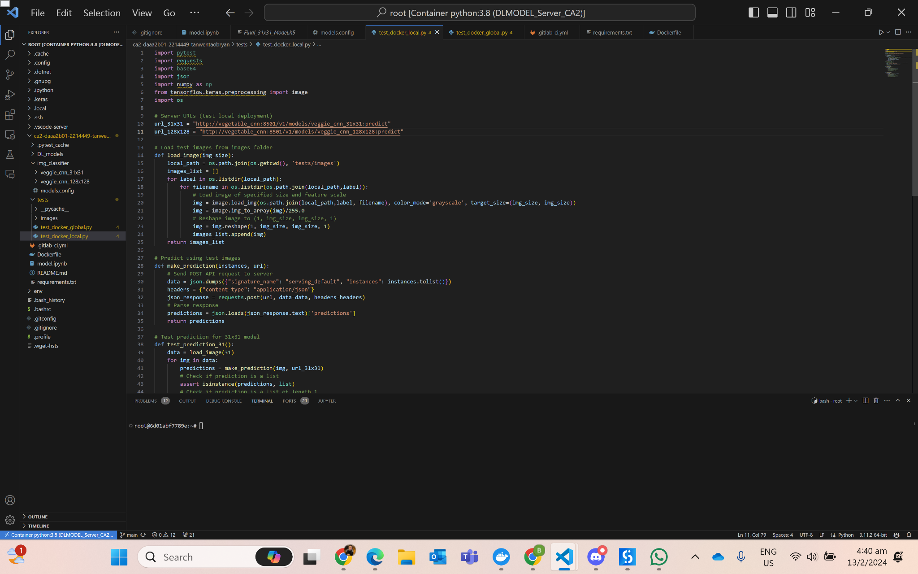
Model Testing
Testing remotely deployed models
Testing locally deployed models

Slide 6
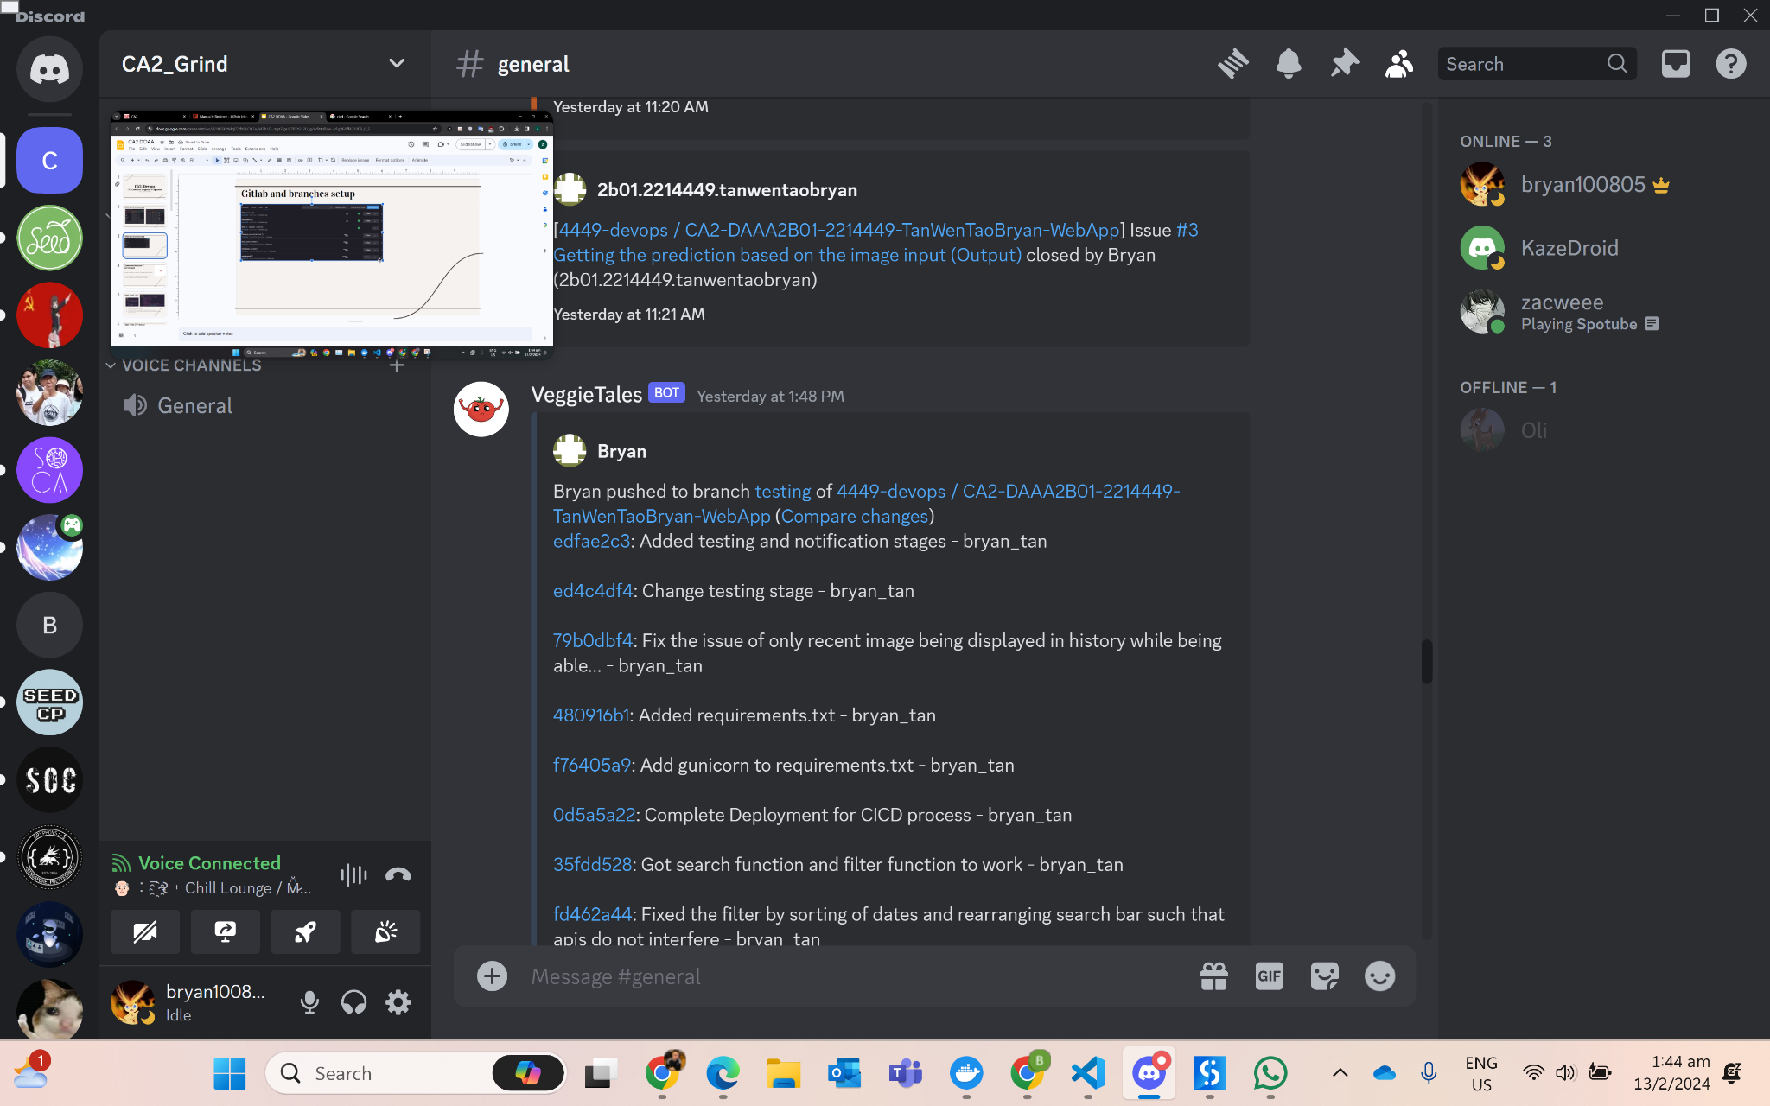
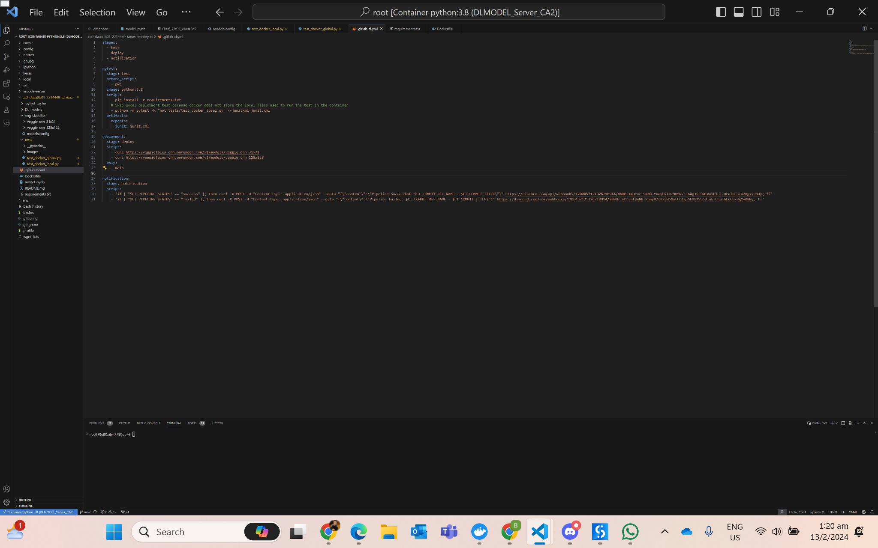
CI/CD Pipeline
3 stages - Test, Deploy, Notification
Continuous Integration - Each commit and merge triggers an automated series of tests using PyTest to ensure changes do not conflict with existing codebase
Continuous Deployment - Every change that passed automated testing will be automatically deployed to production via Render
Feedback Loop - Developers receive immediate feedback, allowing problems to be addressed quickly
Discord - Channel used to inform developers of new issues, closed issues, commits, merge to production branch through webhooks and integration to GitLab
Conducted for both web application and model development and deployment

Slide 7
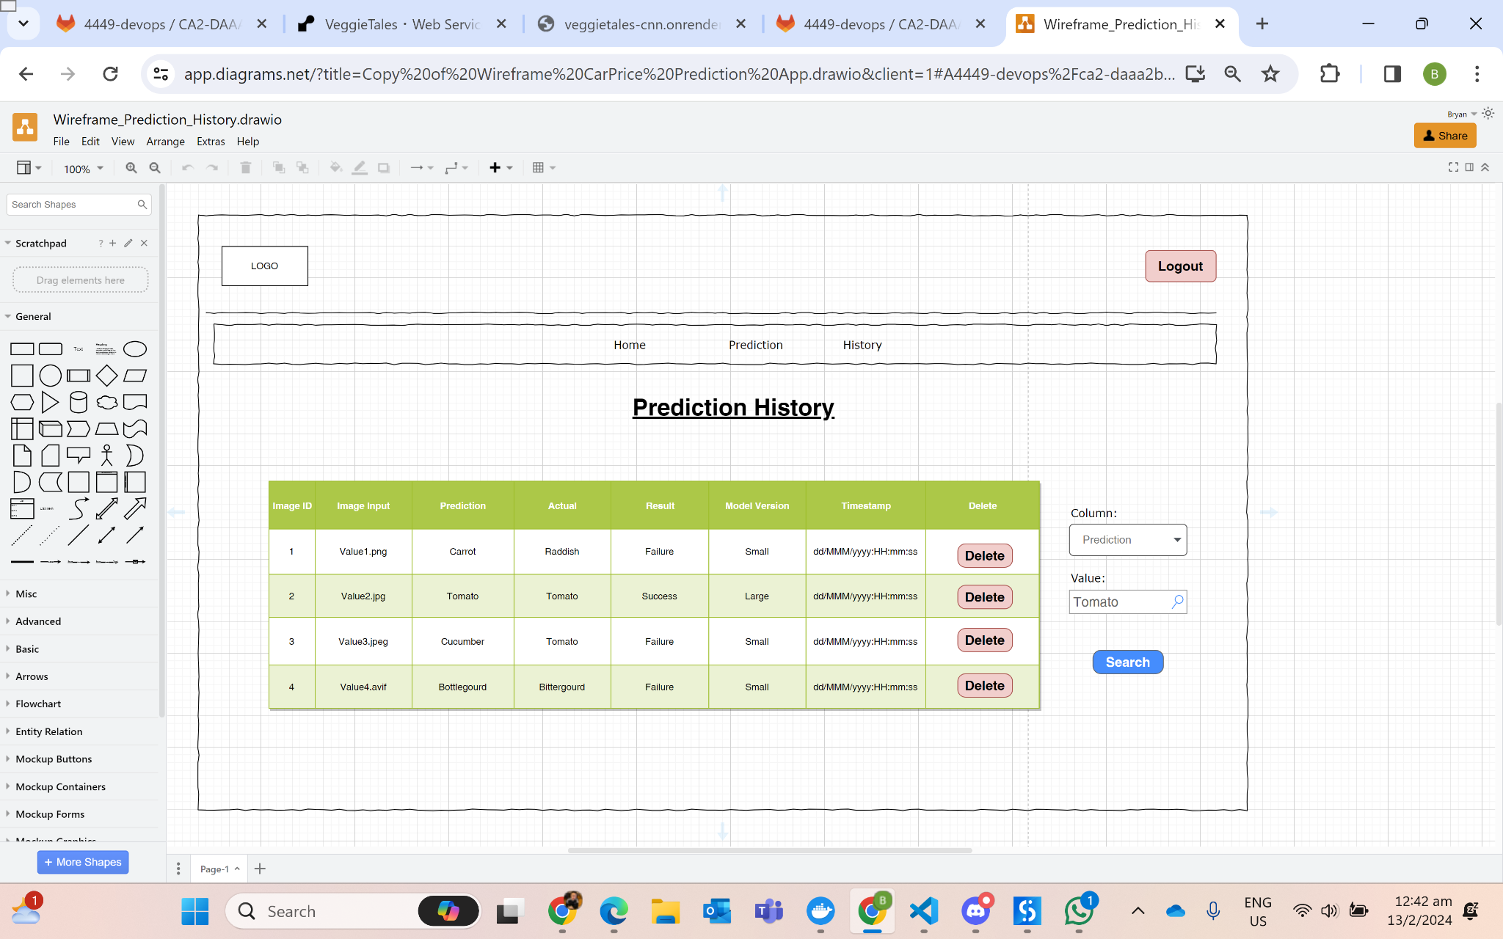
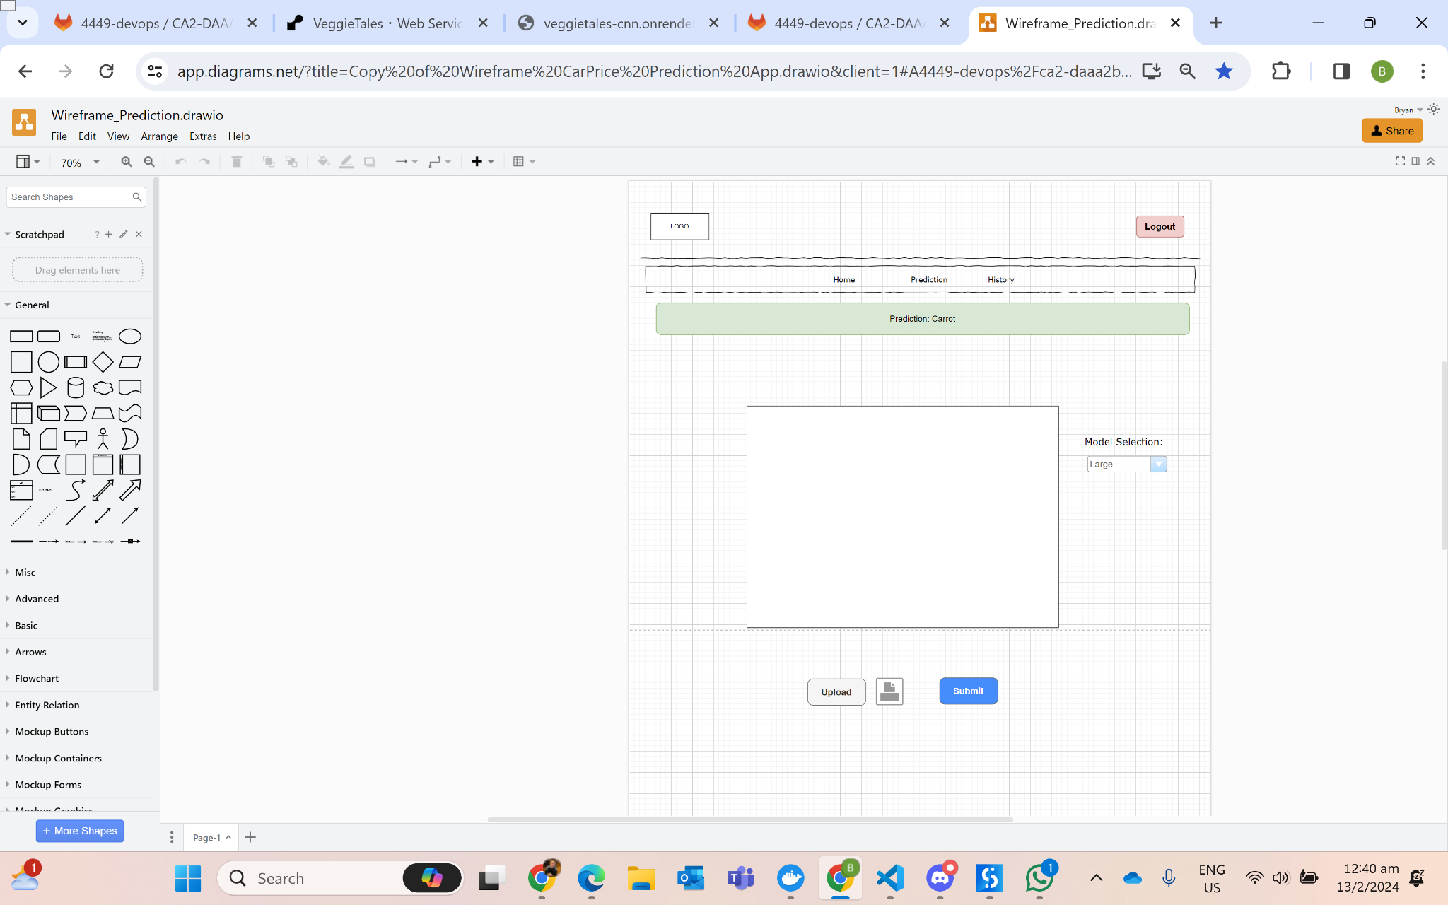
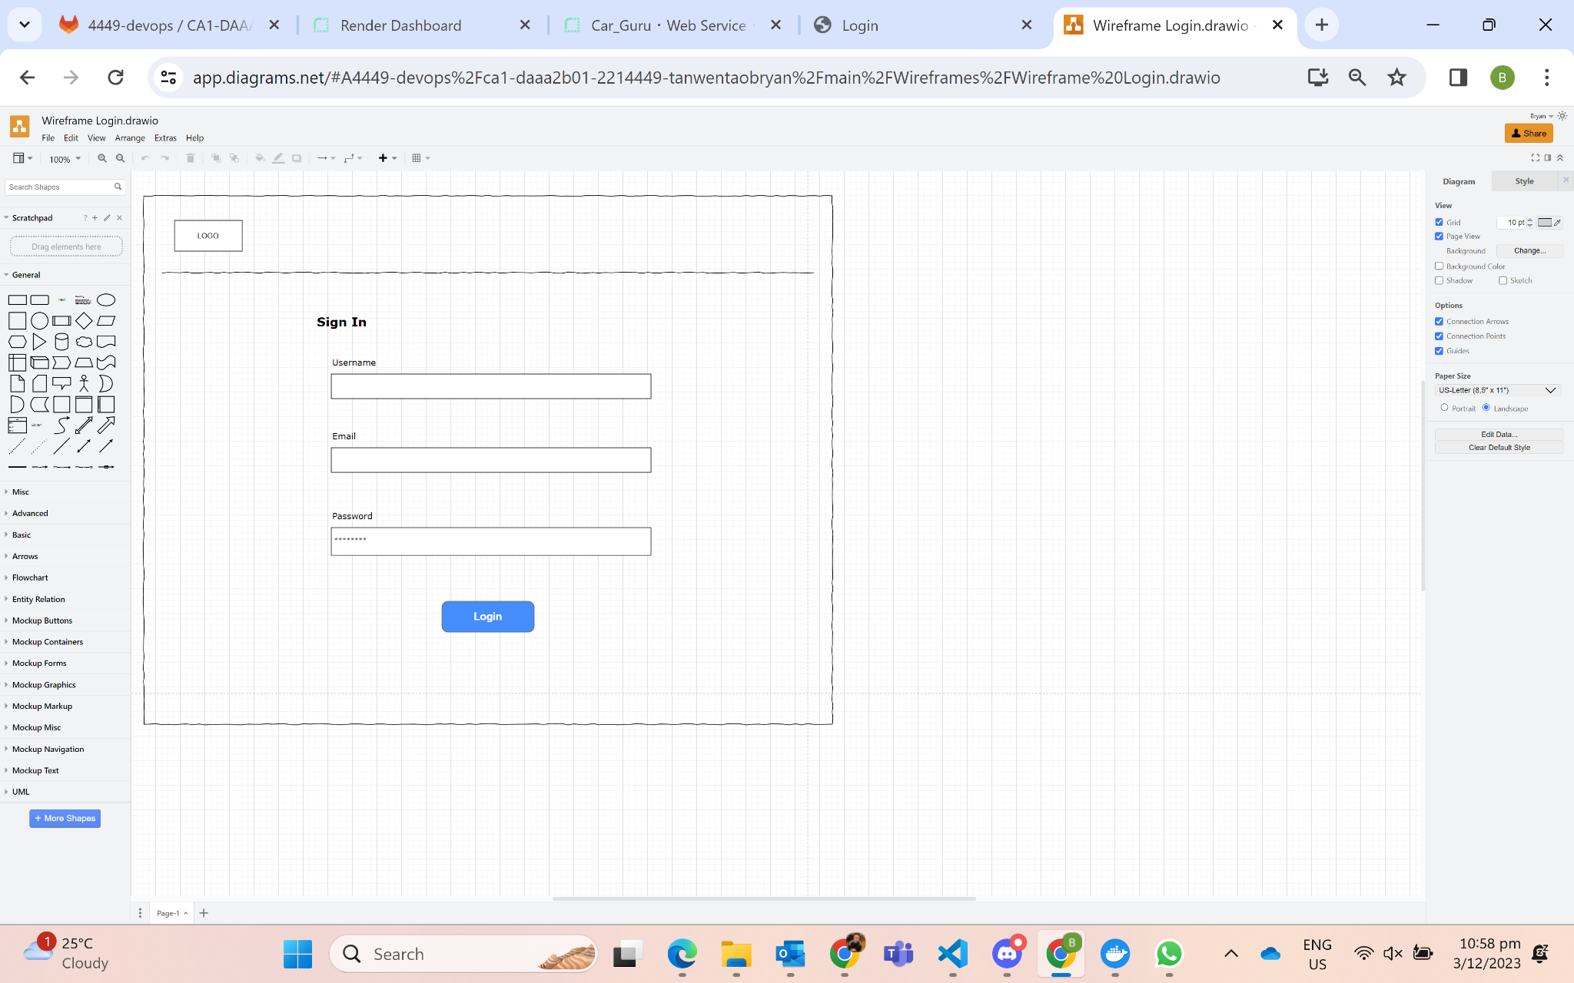
Wireframes (Initial Mockup)
History Page
Prediction Page
Login Page

Slide 8
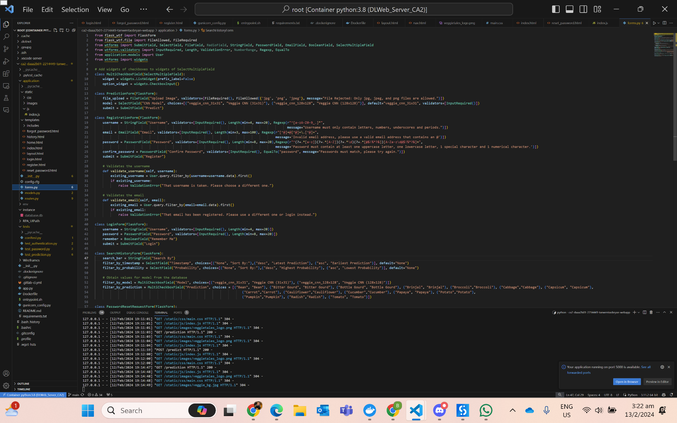
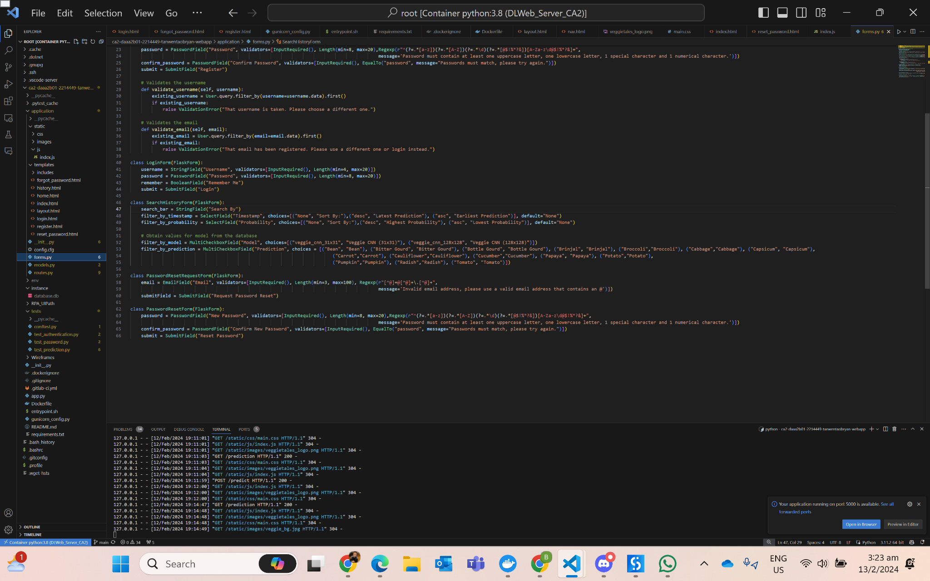
forms.py (Prediction & SearchFilter)
Prediction Form
Search and Filter Form
Prediction Form:
Validators include FileRequired
Allows only certain file types (i.e. jpg, png and jpeg) using FileAllowed, returns custom message
SearchHistoryForm: (Search and Filter)
Allows users to choose the records returned based on certain filters
Accept multiple filters like having records with more than 1 type of predictions (i.e. Tomato & Carrot) and models (i.e. Vegetable CNN 31x31 & Vegetable CNN 128x128)
Return records with certain keywords in search bar
Sort records by timestamp and probability in ascending and descending order

Slide 9
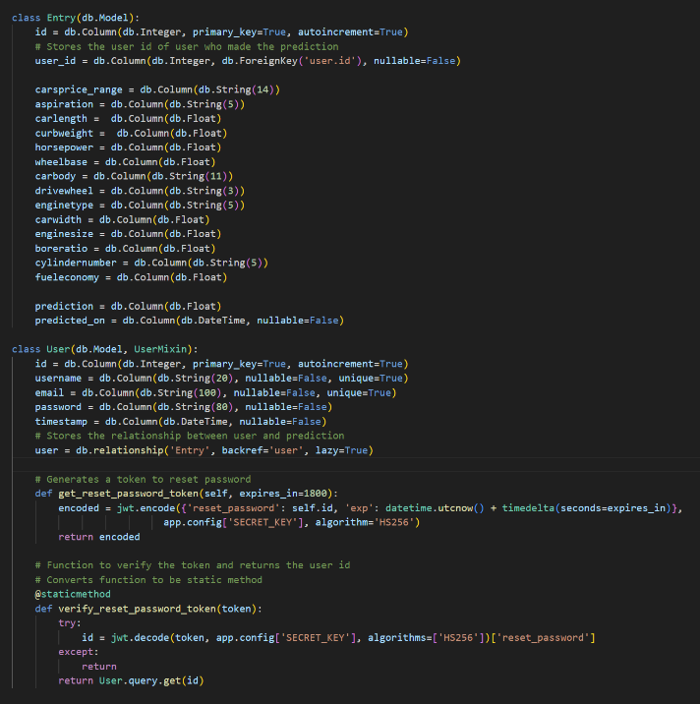
SQLite Database (models.py)
For prediction entries
1-M Relationship:
1 user can have many entries
Foreign Key (user_id) in Entry table reference to Primary Key (id) in User table
For registration & authentication
Password Recovery using JWT

Slide 10
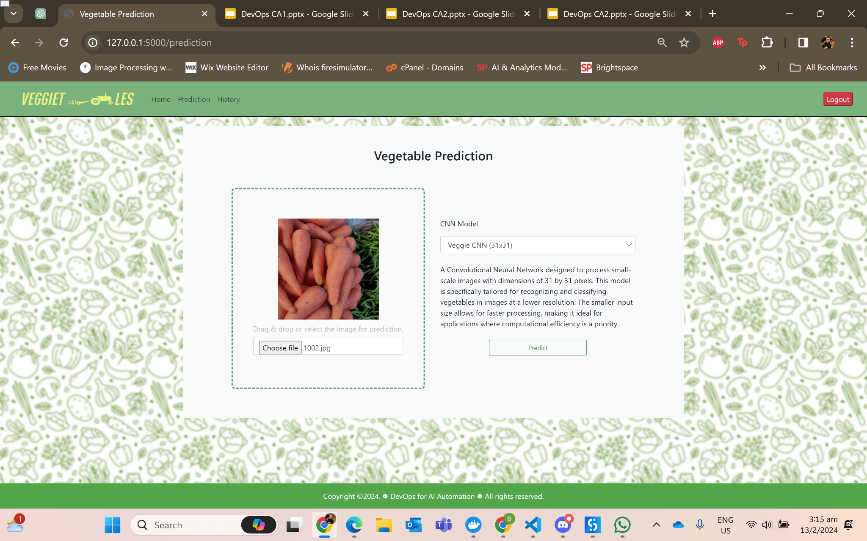
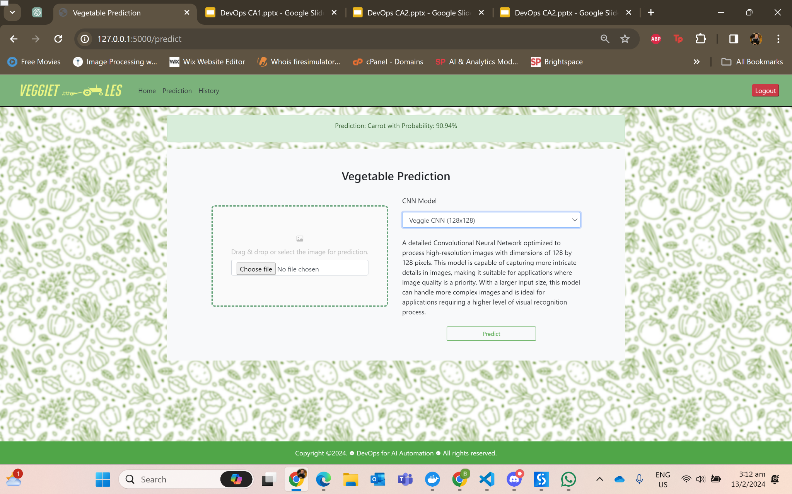
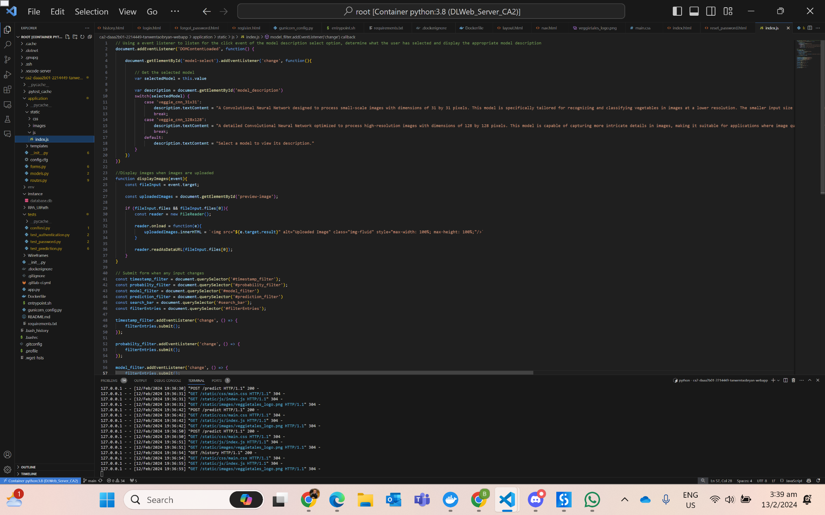
Prediction Page
After
Before
Users can switch models, each caters to different image size
Different models descriptions shown once model has been selected
Prediction and its probability will be flashed above the canvas
Images with (i.e. .png, .jpeg, .jpg) extensions are accepted and can be displayed once file is uploaded, does not accept non-images file

Slide 11
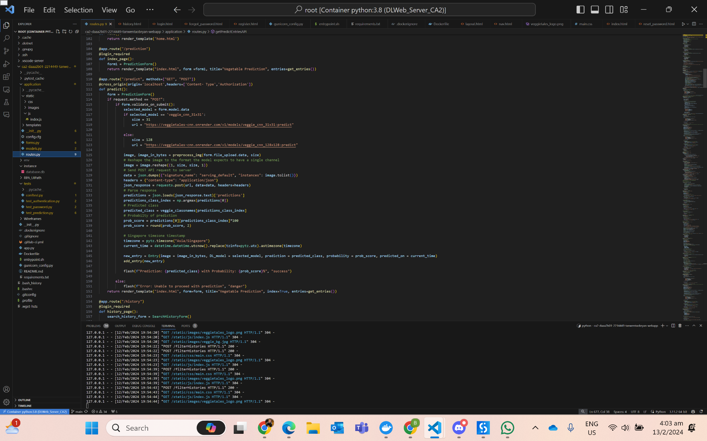
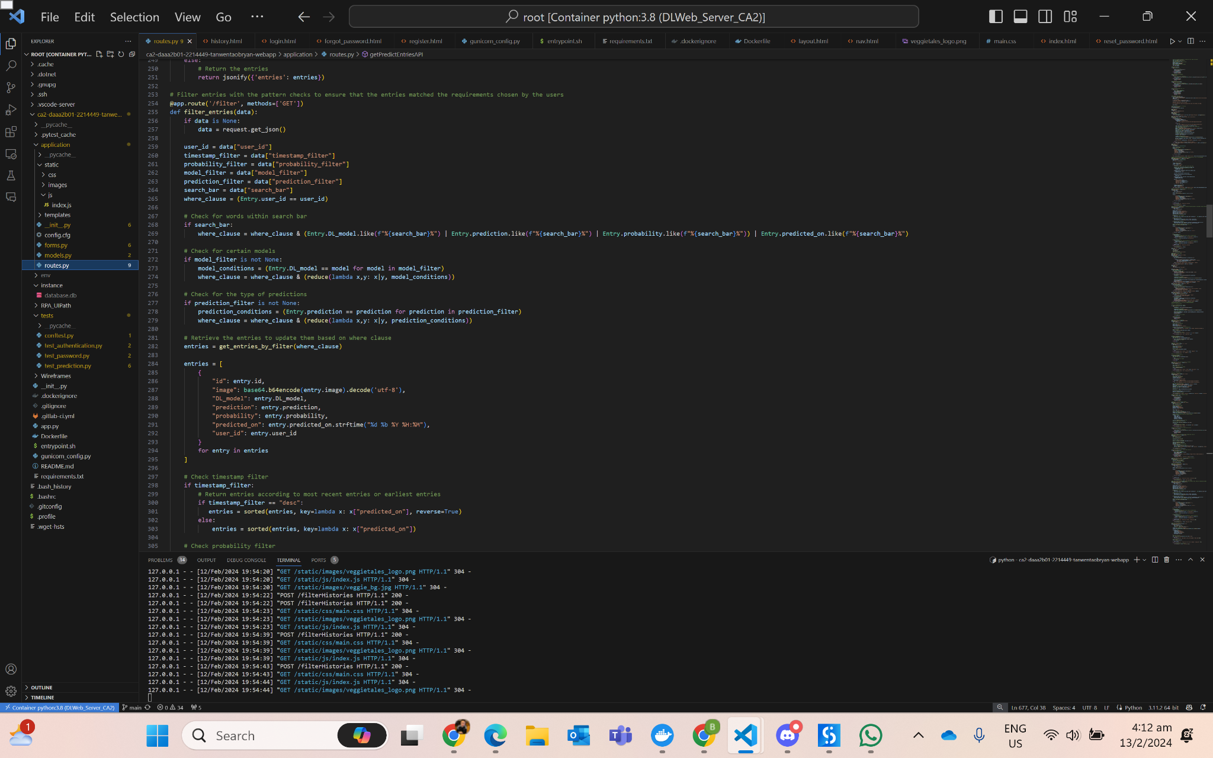
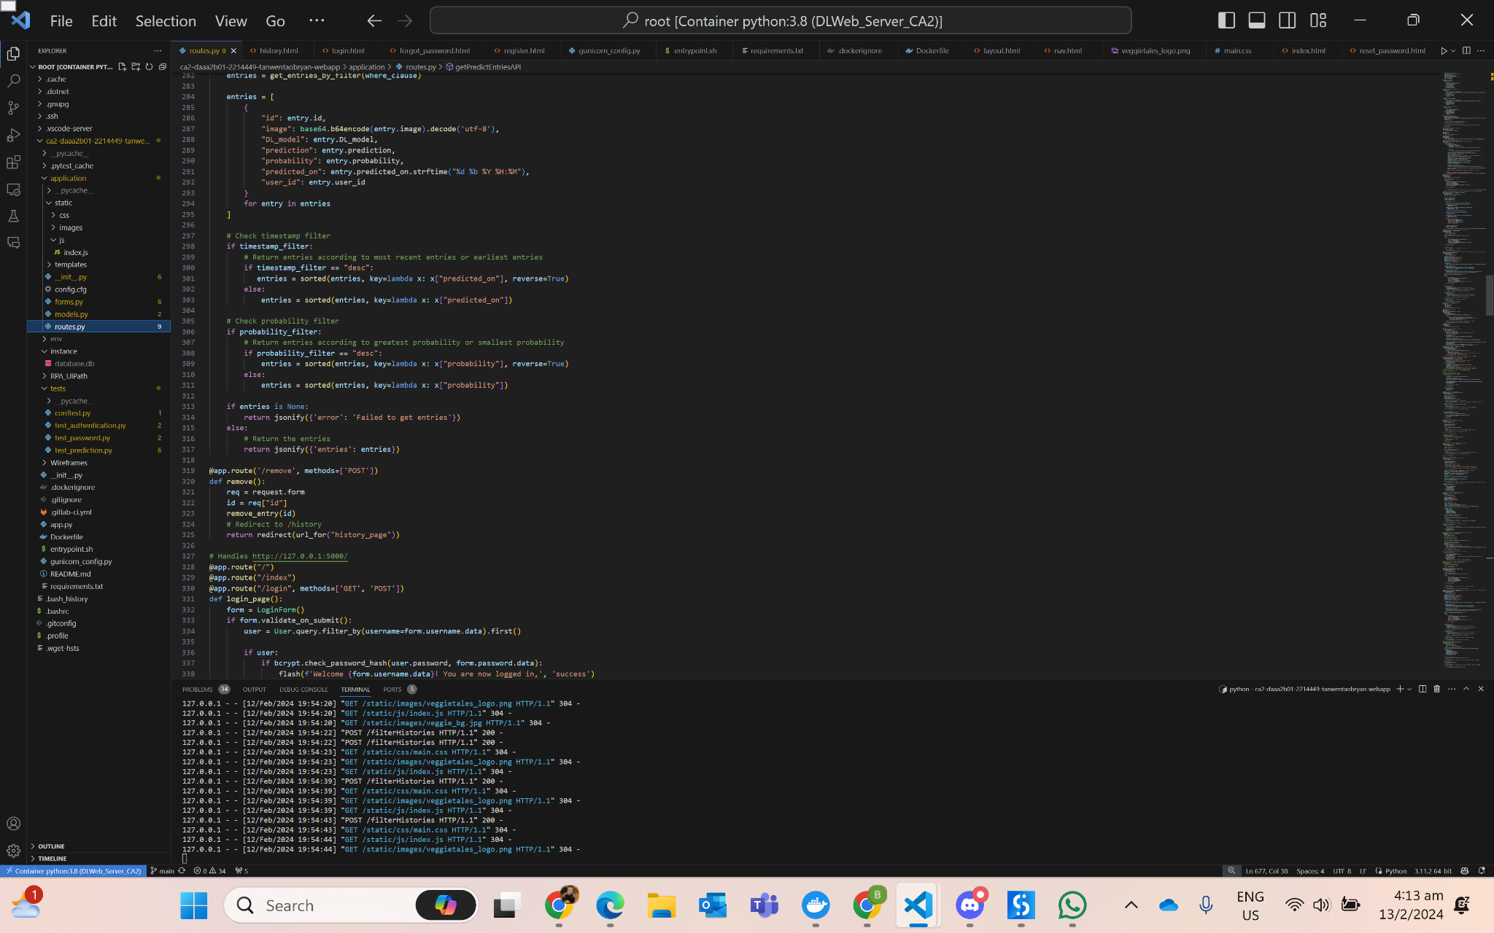
Prediction Page
Using regex to check for certain keywords in search bar
Reduce entries such that it matches filters for model and predictions
Sort entries according to timestamp/probability in ascending/descending order
Predicts the test data based on the models deployed and served in Render previously

Slide 12
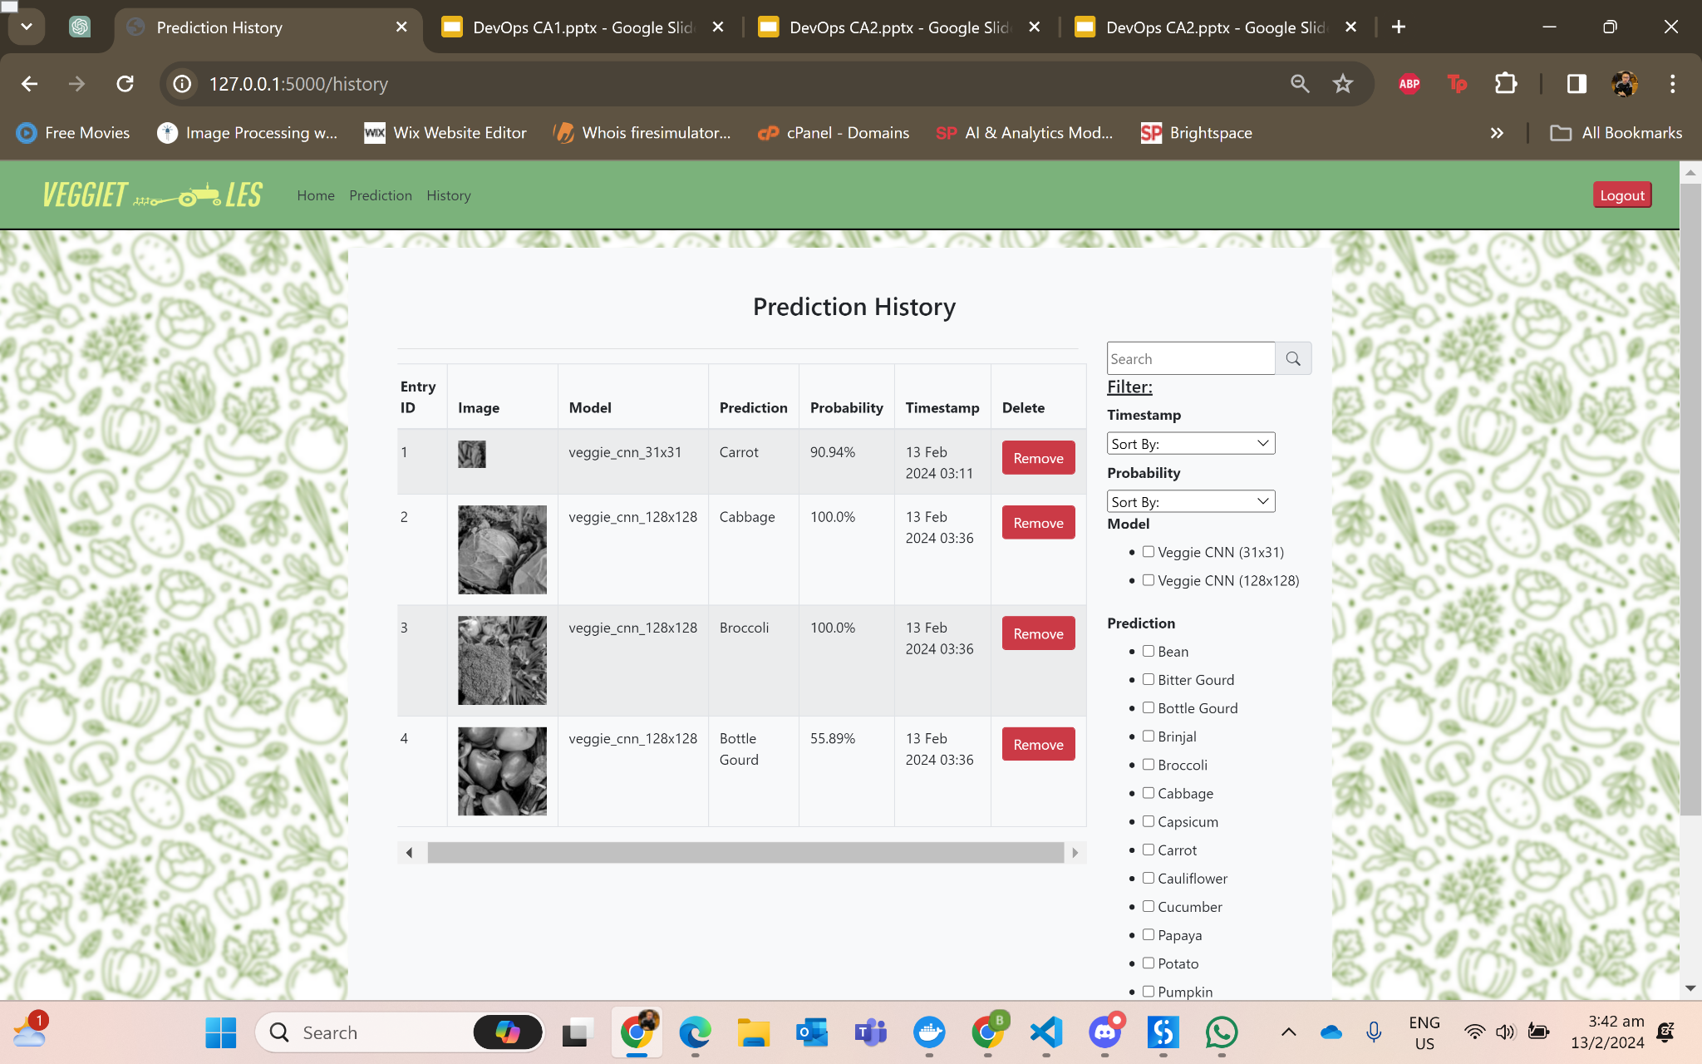
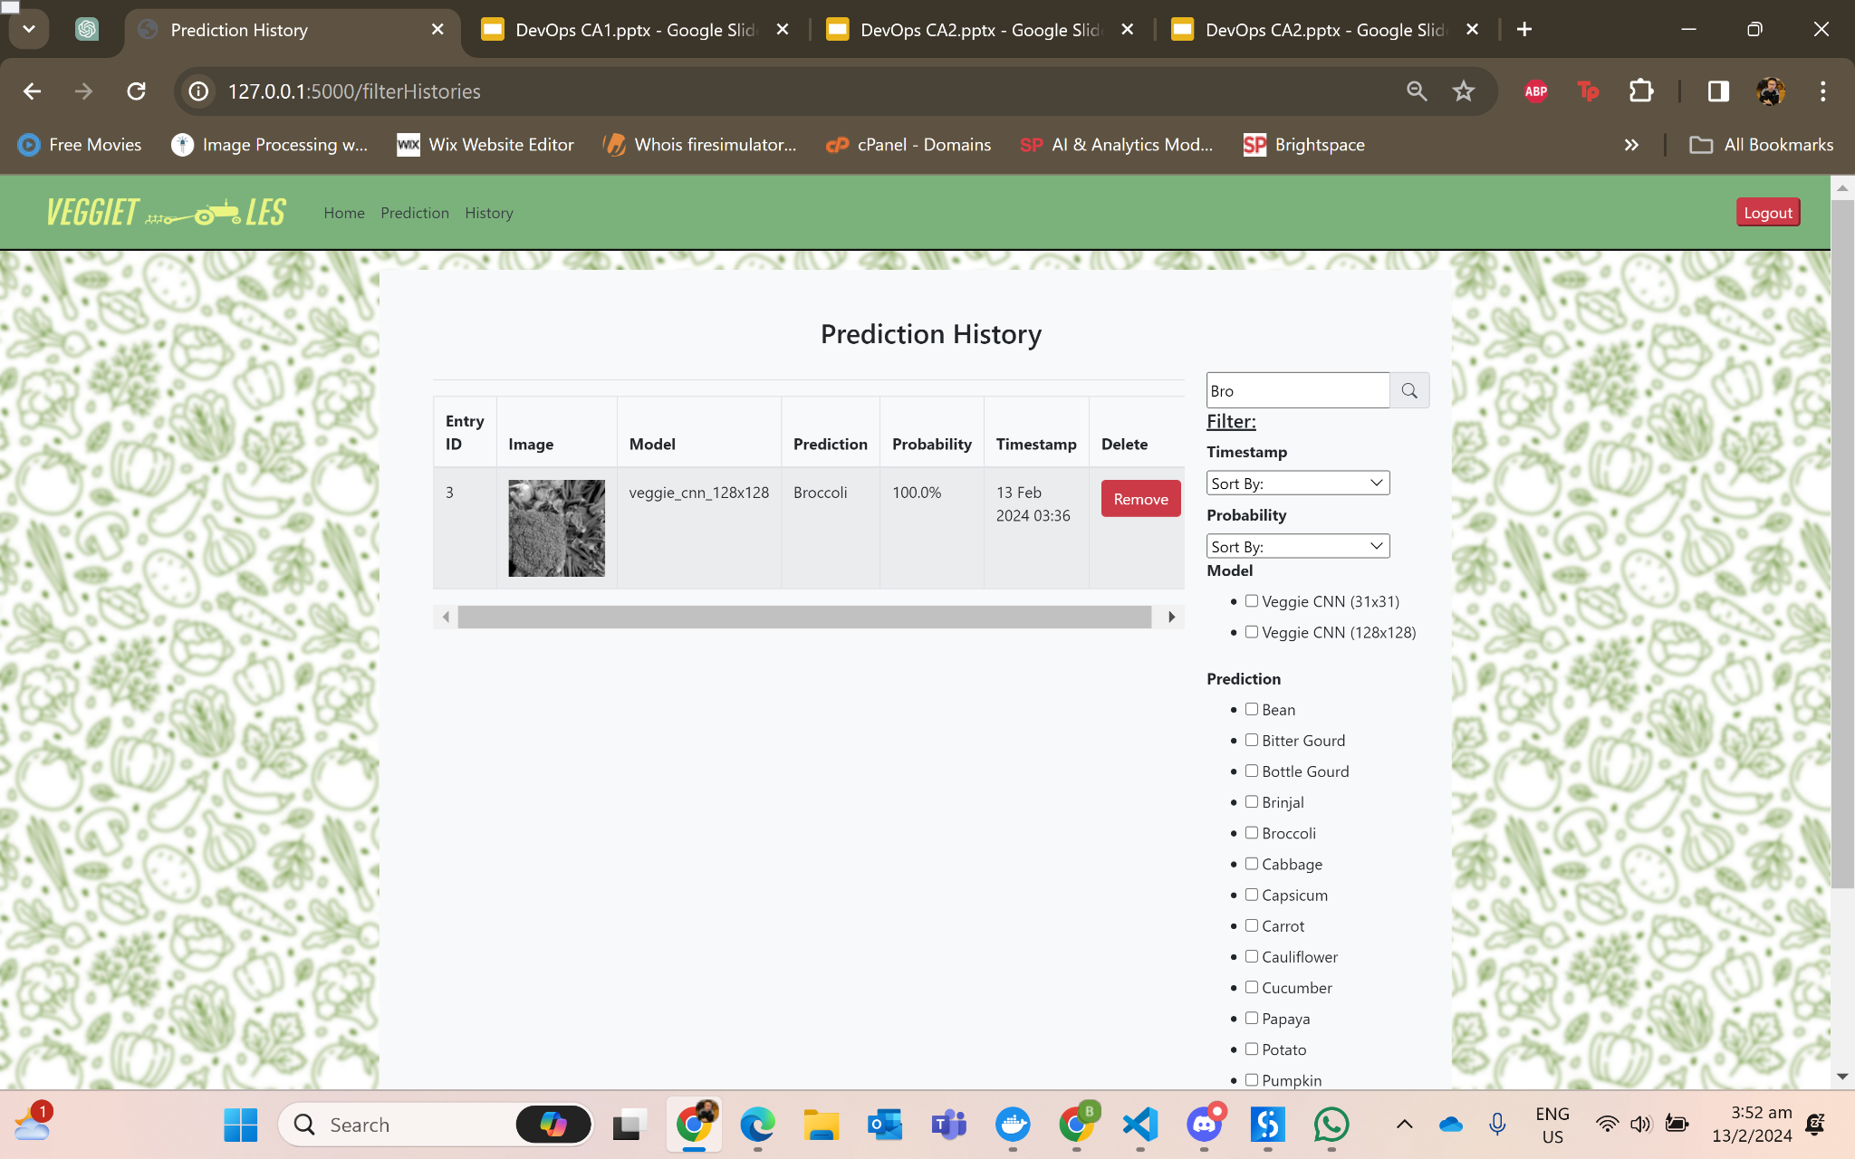

History Page
Filter phrases that contains ‘Bro’ in search bar
Filter records predicted by Veggie CNN (128x128) and Bottle Gourd in checkboxes
Users can search and filter records as listed before
Images are displayed in each record
Users can remove entry when needed

Slide 13
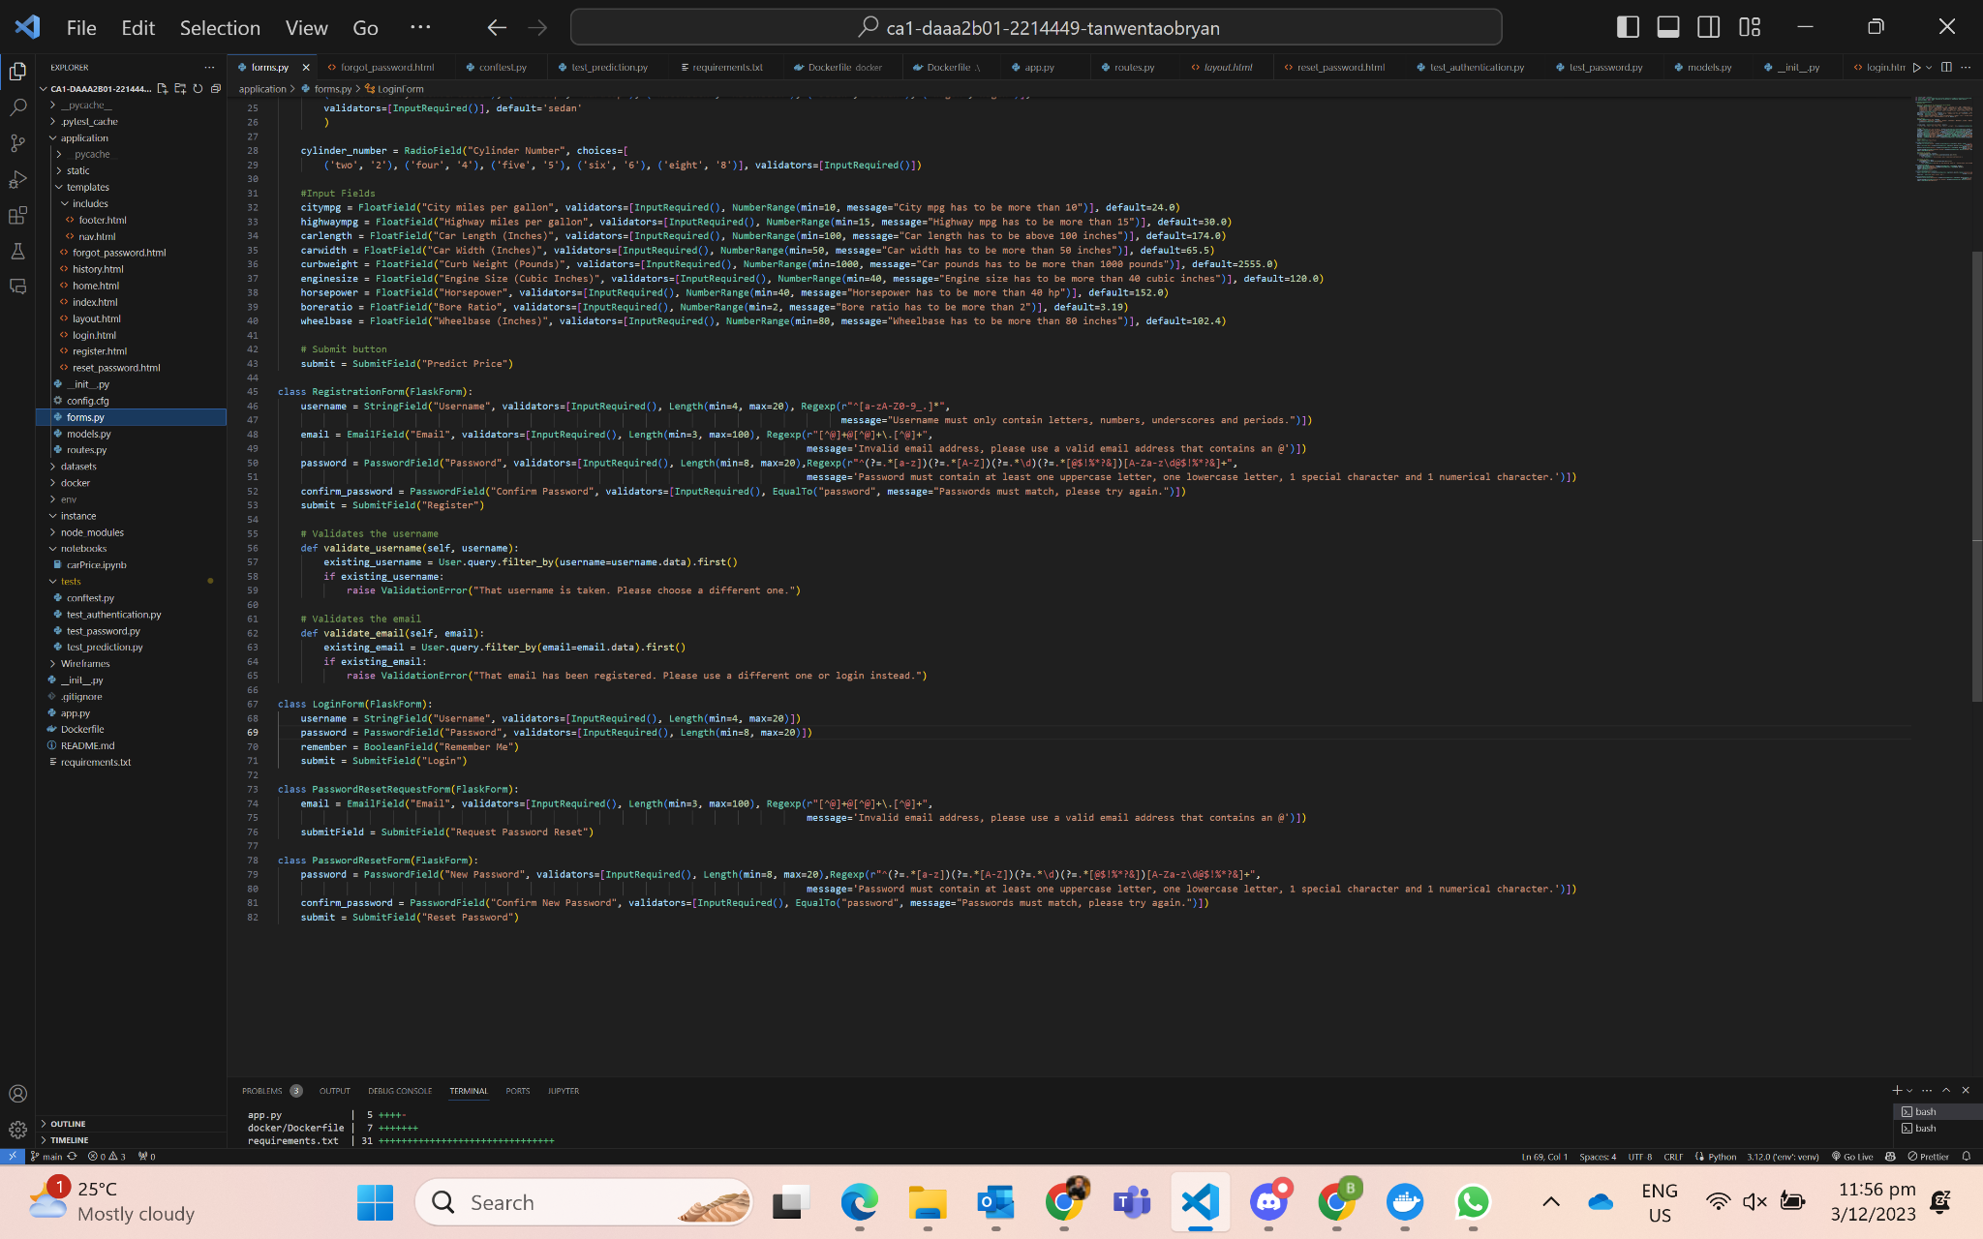
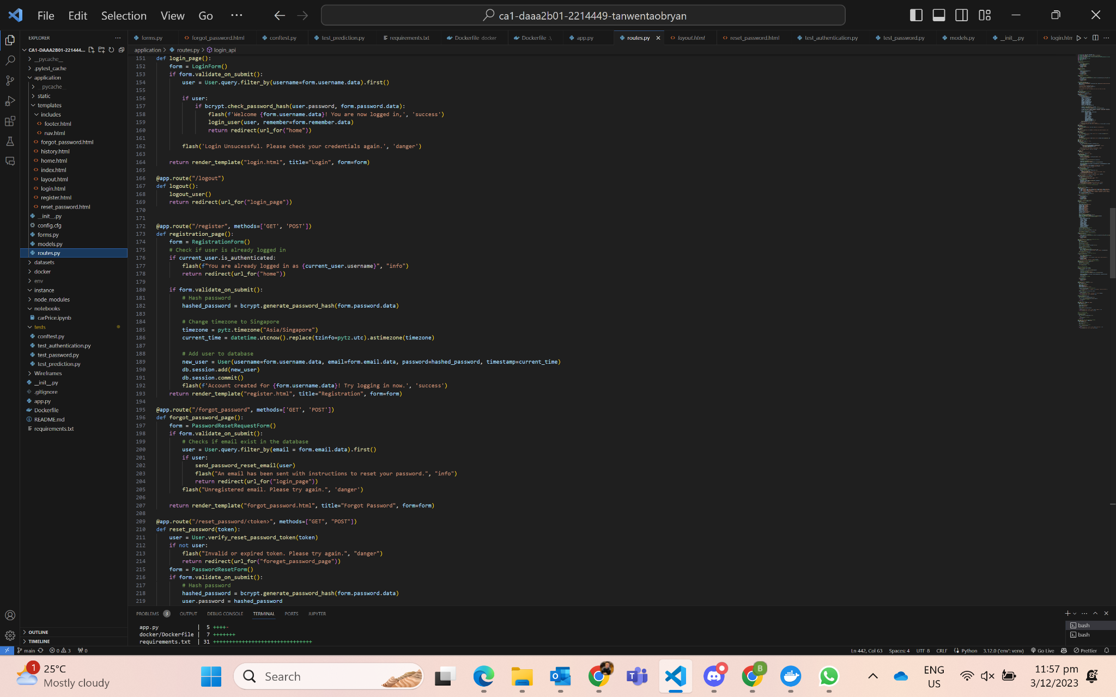
Registration (Flask-Login)
Rejects access if user is authenticated
Form Validation (Registration):
Input Required
Length (Min & Max No.of Characters)
Regex (Patterns)
Username allowed letters, numbers, underscores and periods
Email must have content in front and behind @
Password must have at least one uppercase letter, one lowercase letter, 1 special character & 1 number
Confirmation Password to match Password
Validation methods to check for existing data
Encode password by hashing it upon submit
Render form by connecting to server

Slide 14
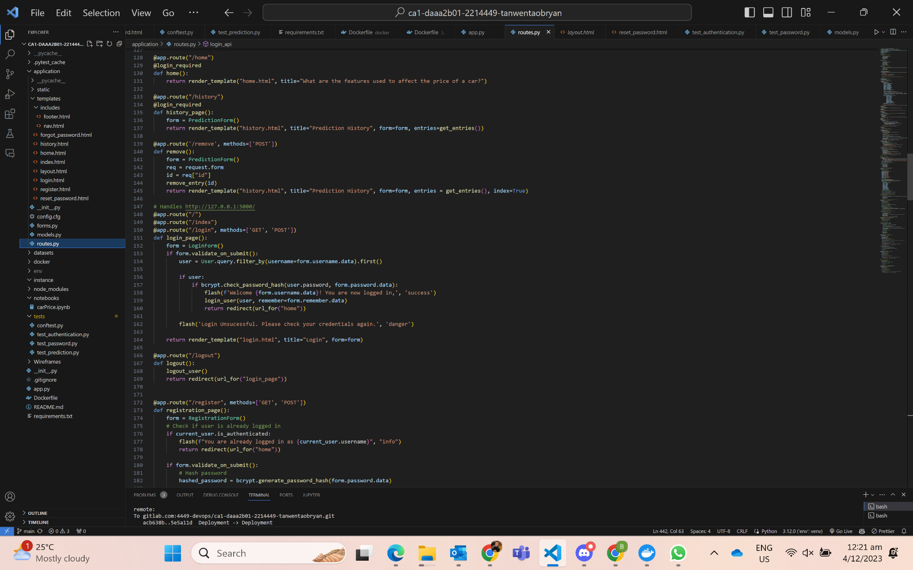
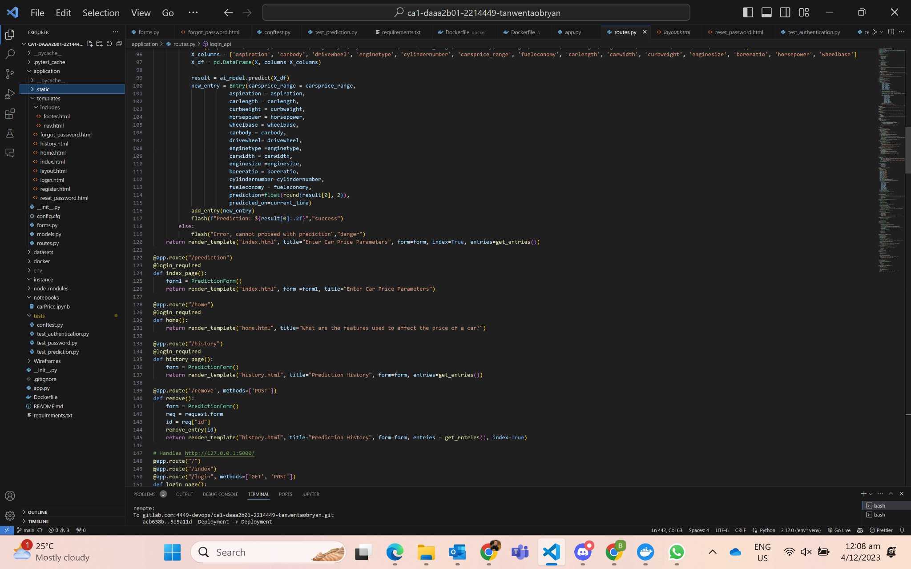
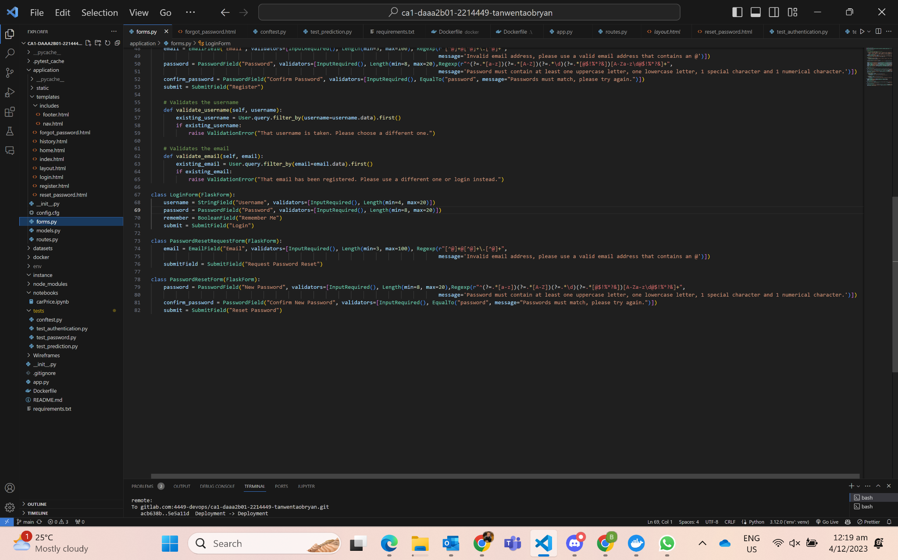
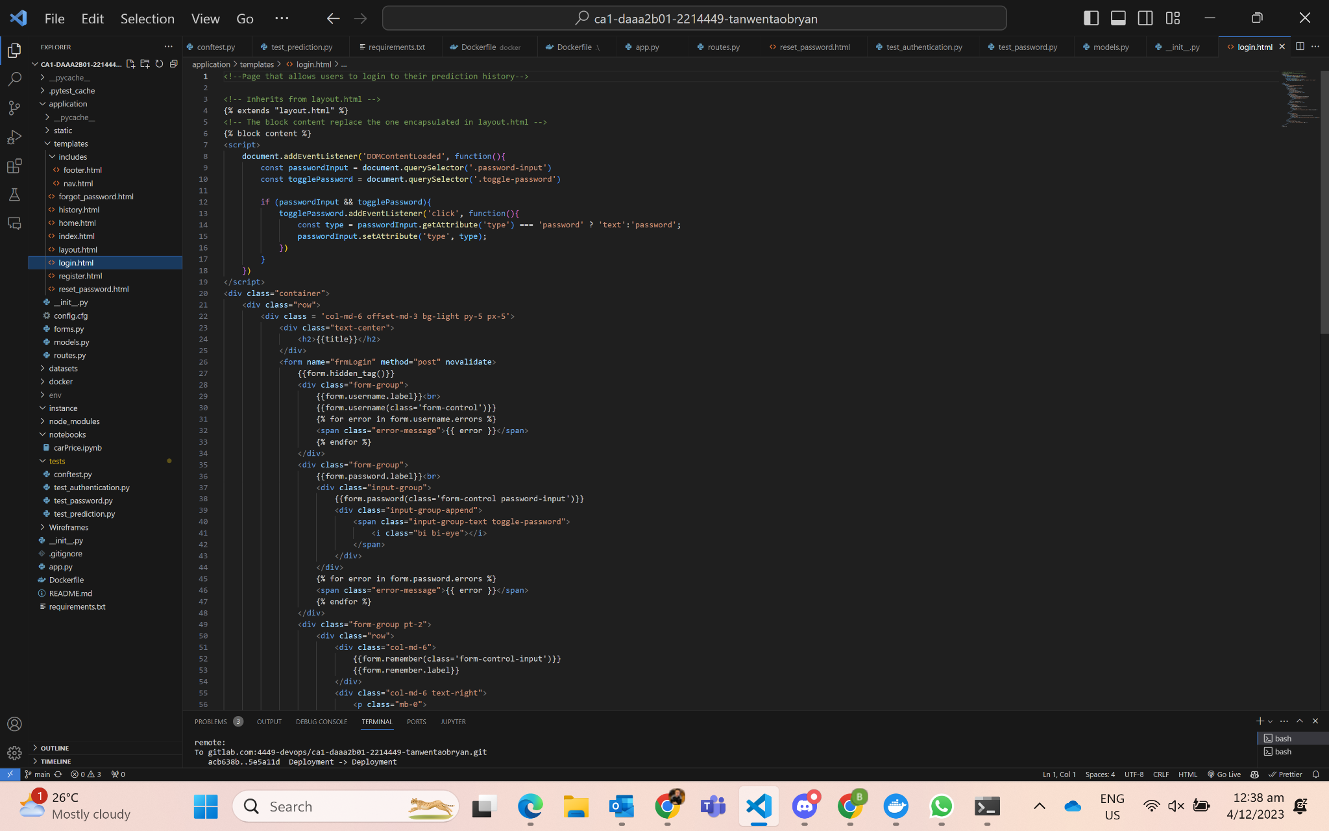
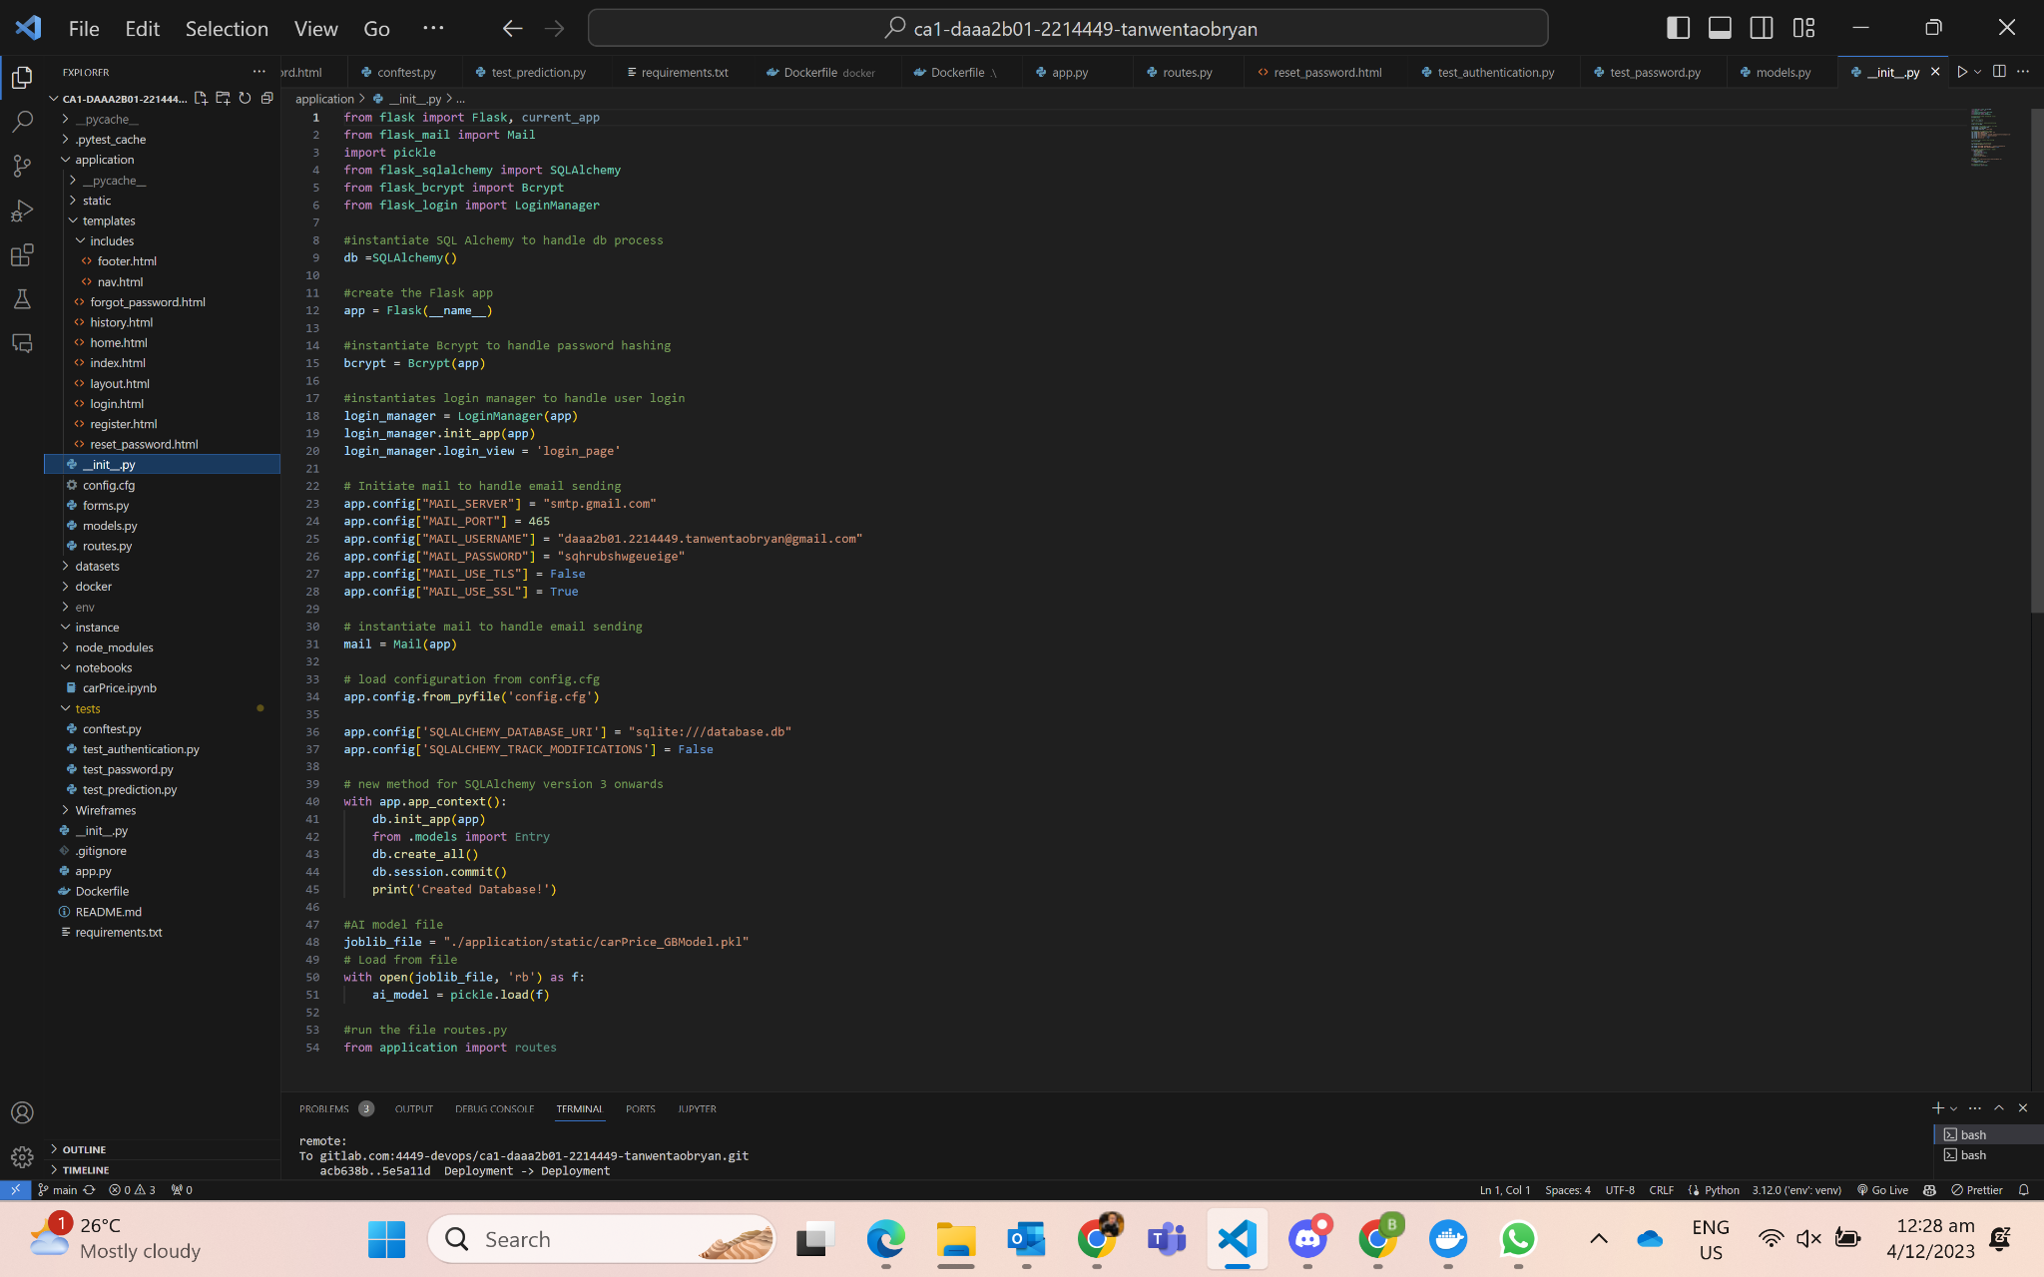
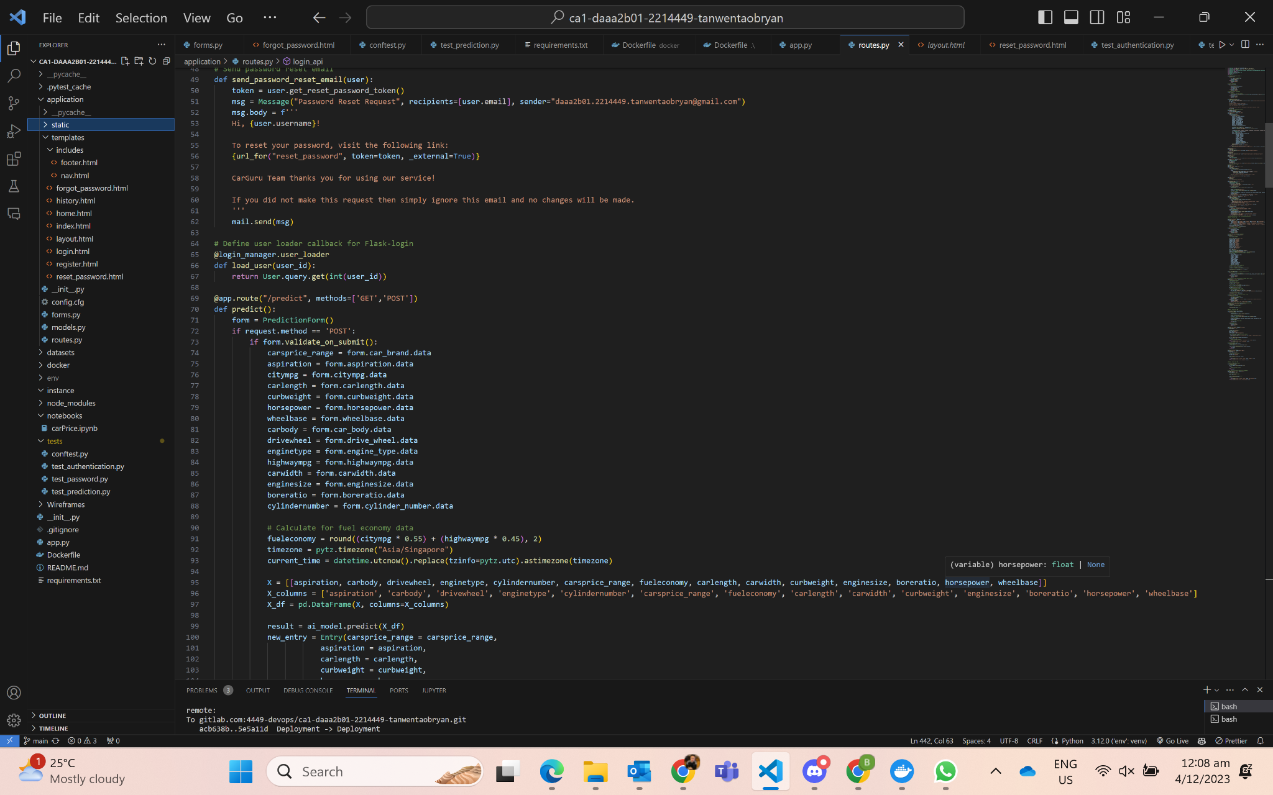
Login (Flask-Login)
requires login to access
checks if user exist in database
checks if password stored matches password in form
logout user
allows local storage to remember user
Instantiating Bcrypt and LoginManager
Toggle password between text and hashed password for ease of readability

Slide 15
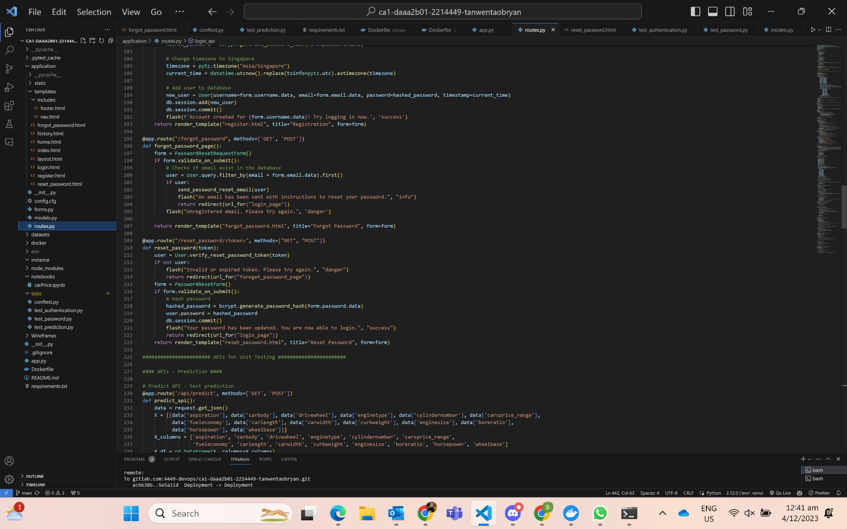
Password-Recovery (Flask-Mail)
Uses SMTP to secure a port 465 between Flask and Gmail.
Enable 2FA to generate a password such that Flask can access my gmail to send the link to the user’s email with a link they can use for password recovery for secure password update.
Password Request Form:
Verifies user by validating user’s email keyed in matches the one stored in the database
Password Reset Form:
Creates more secure password resets with JWT tokens, user can’t forge tokens
Verifies token by checking if it matches
Hash password that user key in and commit to database

Slide 16
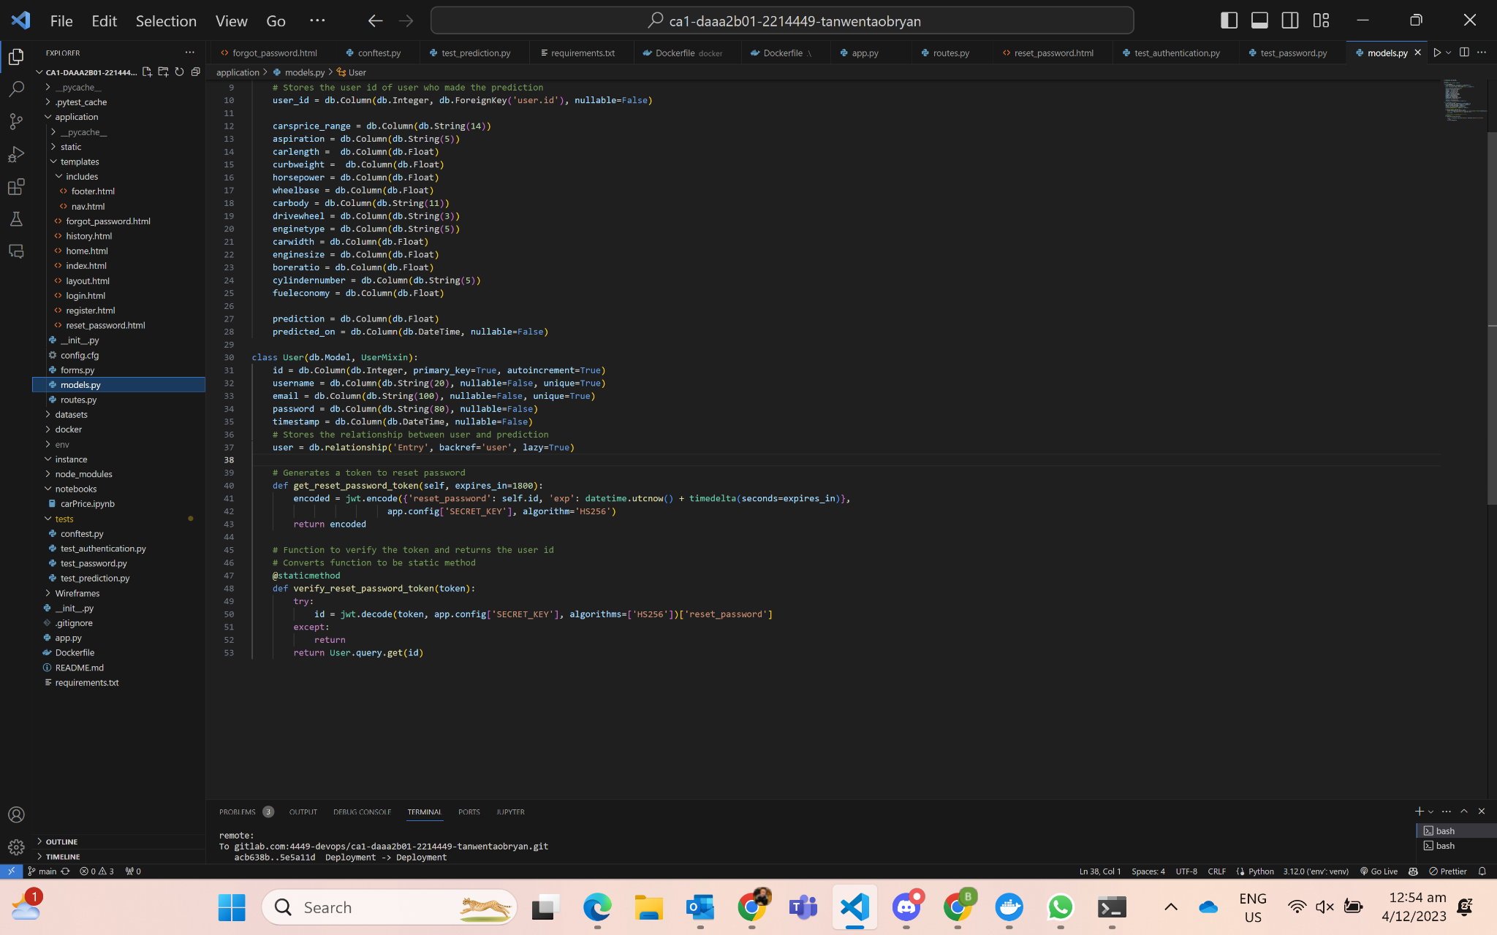
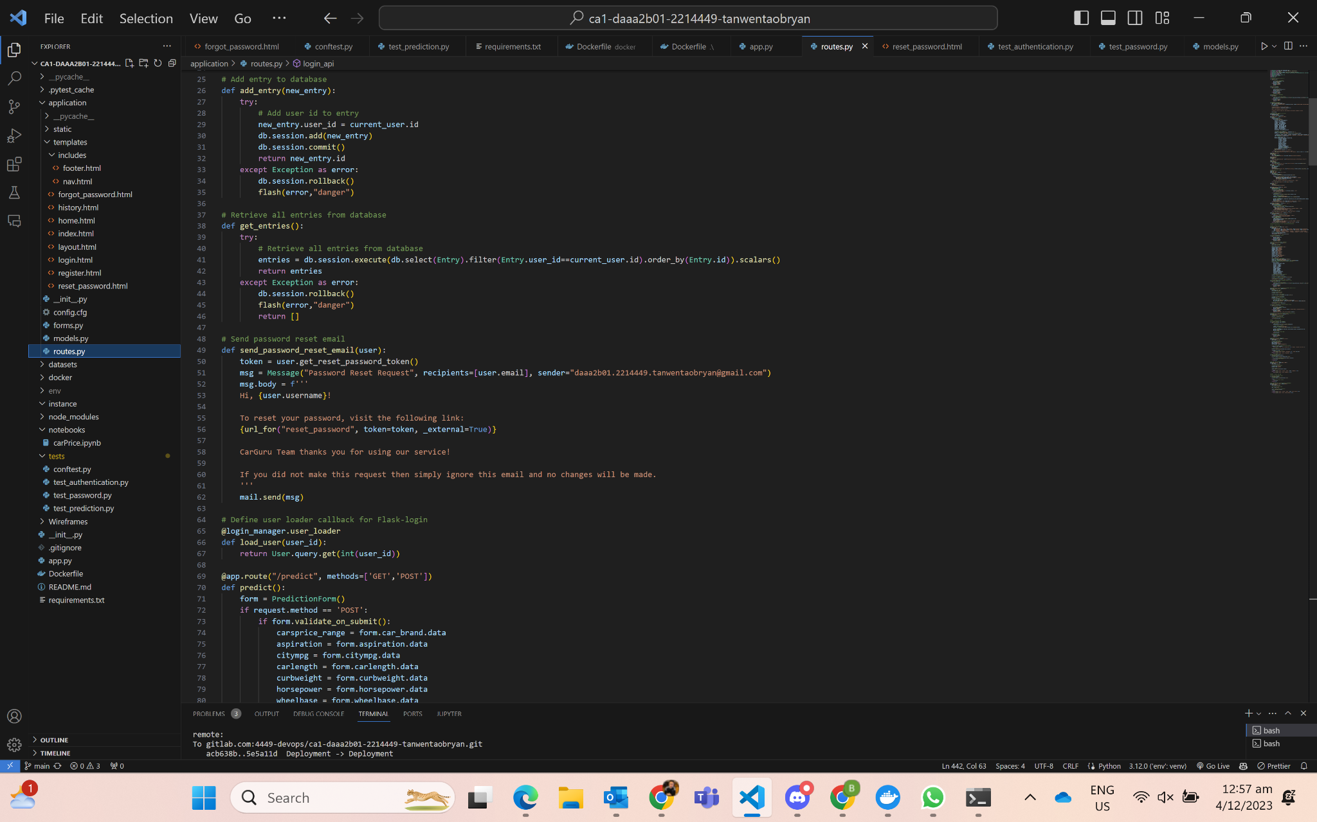
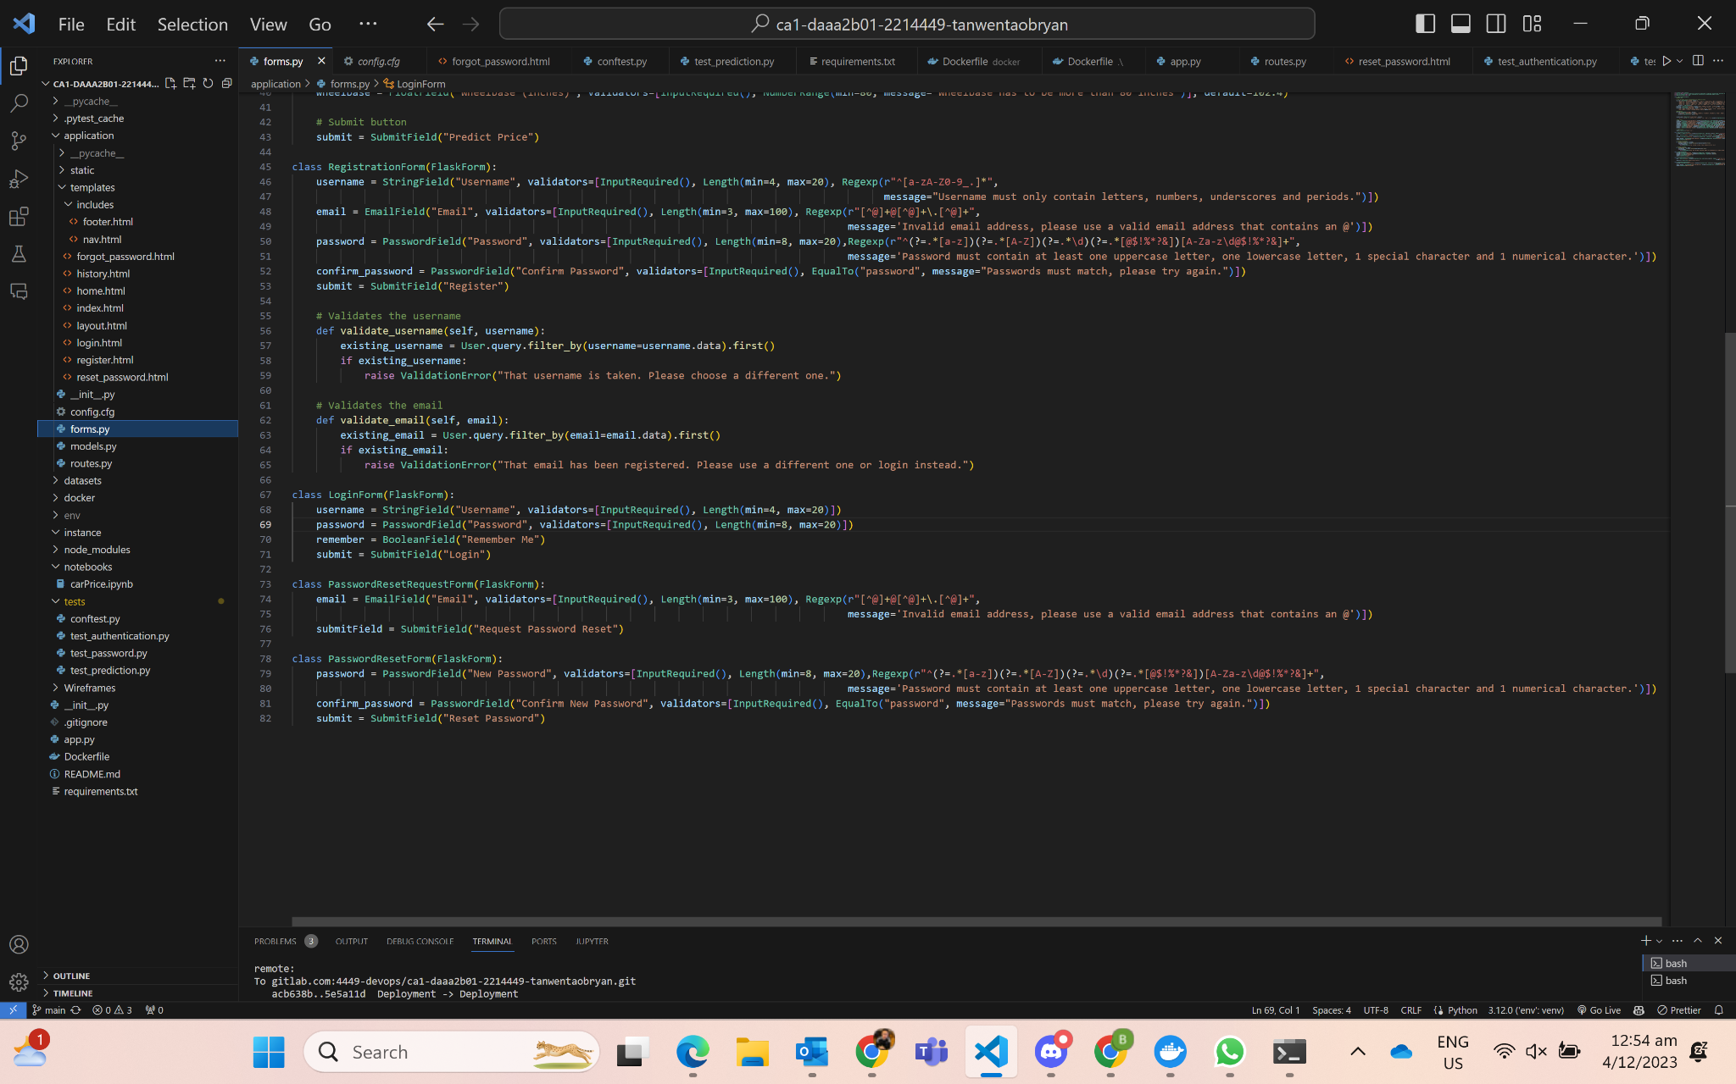
Password-Recovery (Flask-Mail)
Top:
1) Encode the token.
Stored on the client-side, and it is used to authenticate all requests until it expires.
Once the token expires, the user has to generate another one, and the cycle continues.
2) Decode the token to verify token and return the userid
Top:
1) Sends message to recipient from user with the token for the user to use to update his/her password
Bottom:
1) Same sort of validation for email and password
Password Request Form & Password Reset Form

Slide 17
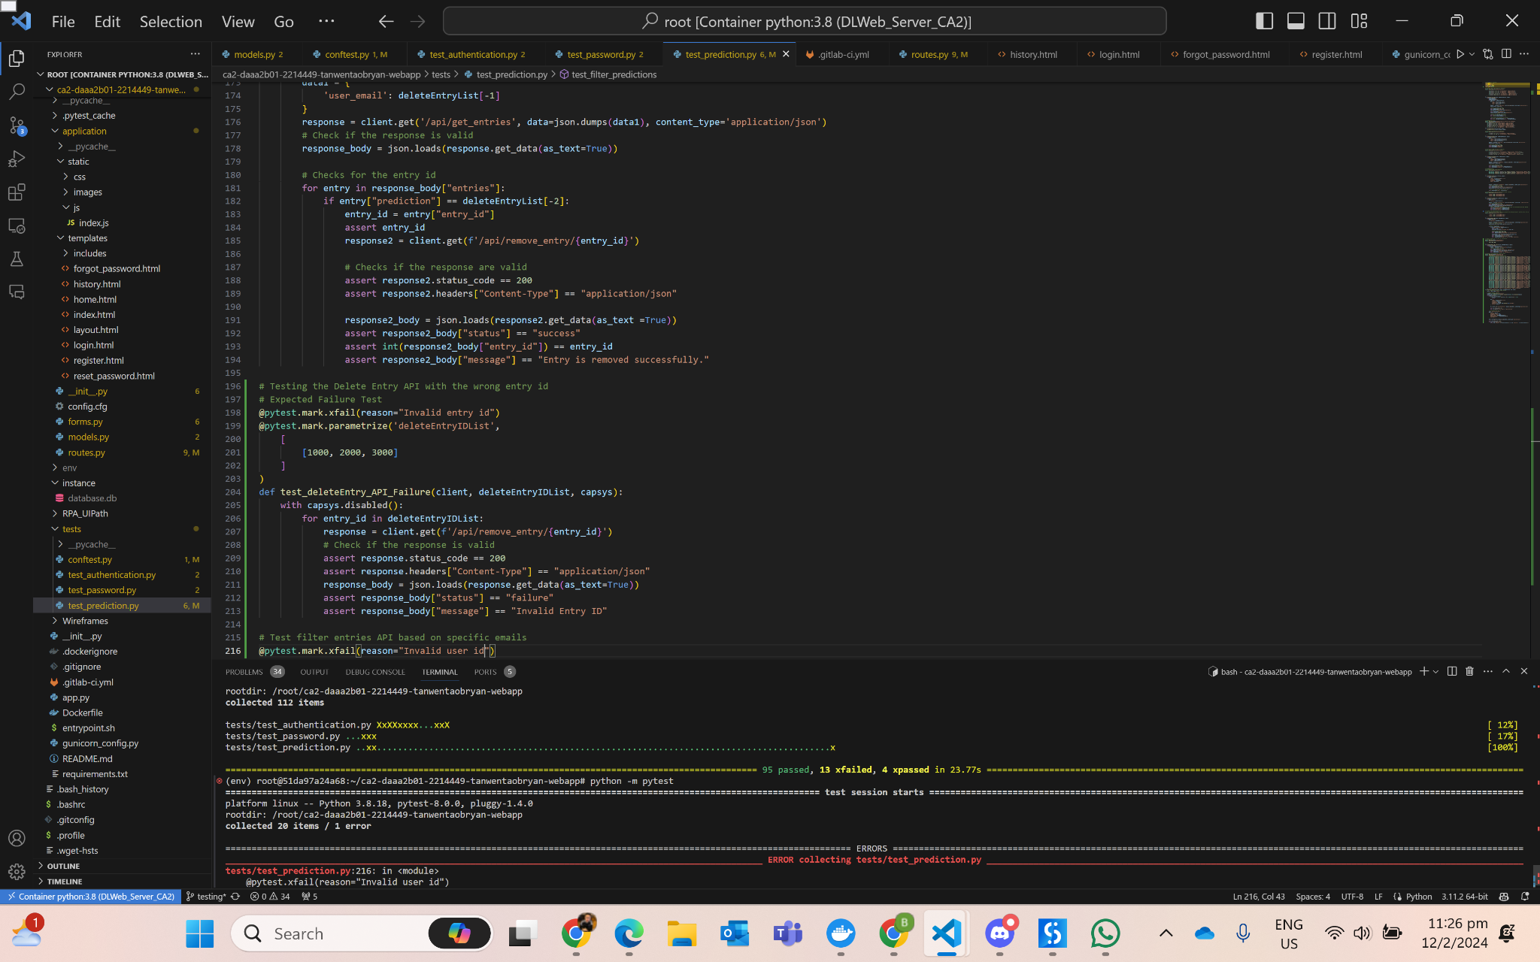
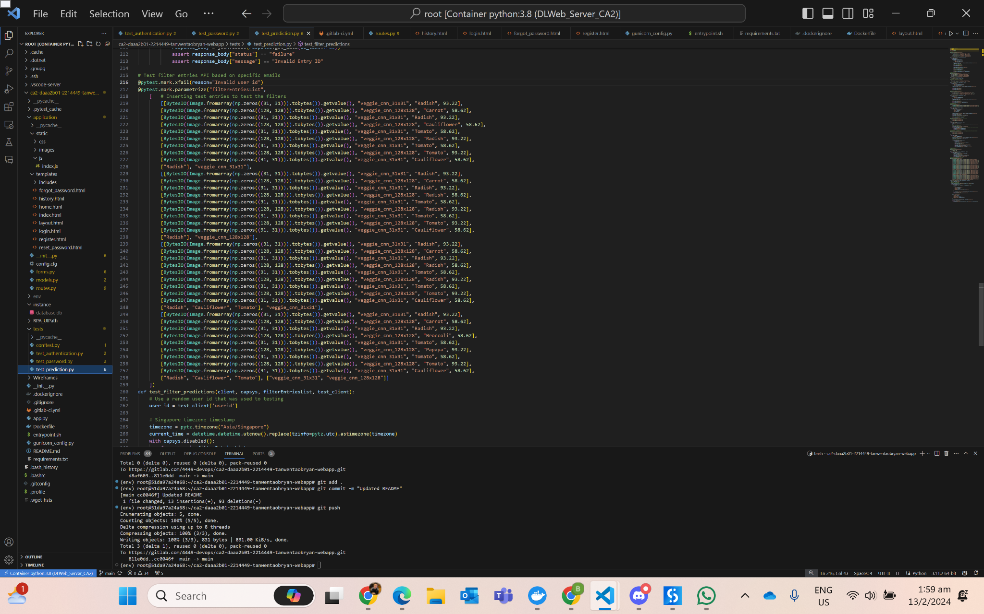
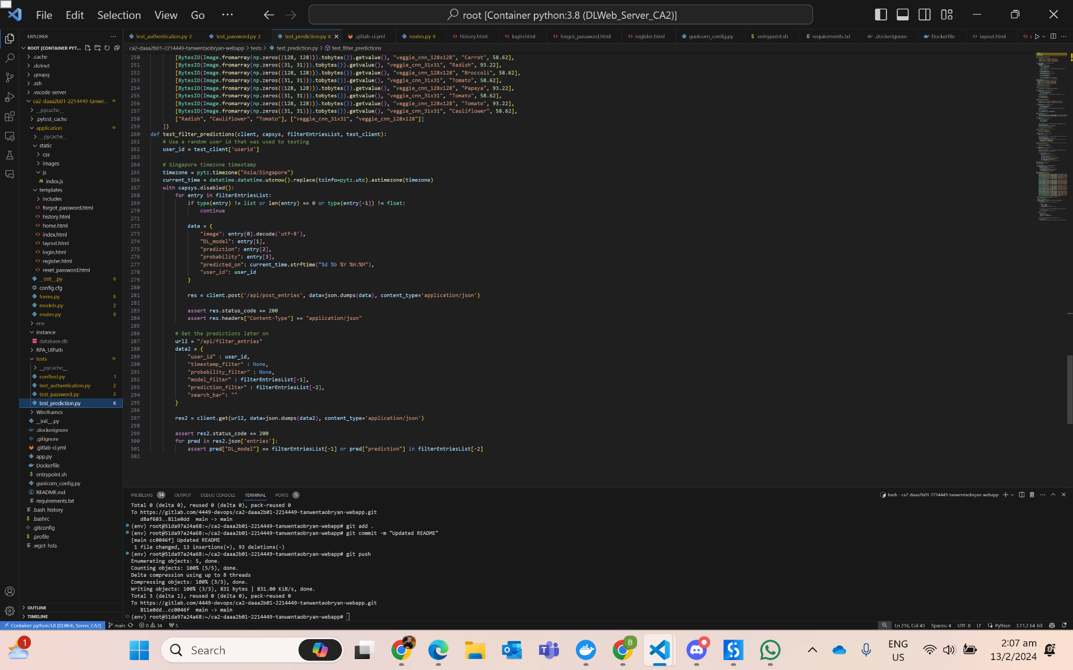
Automated Testing
Create RESTFUL APIs for testing to demonstrate the features and APIs are working with the use of PyTest
Web Application: login, registration, predict, add_entry, remove_entry, get_entries, email_verification, filter_entries
Model Deployment: ensure prediction works for local deployment and remote deployment
Test Filter Entries (Case Scenario)
Return records that filters certain predictions and models
Test Filter Entries (Filter Predictions & Models)

Slide 18
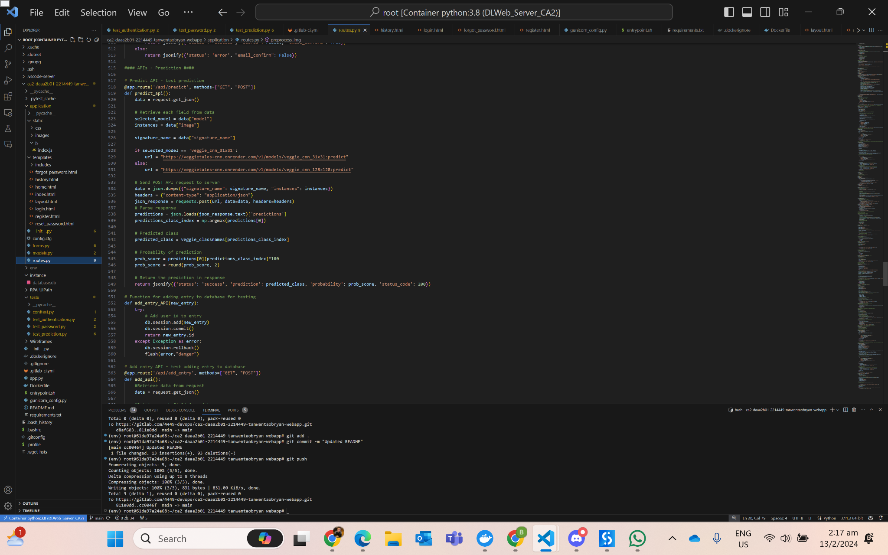
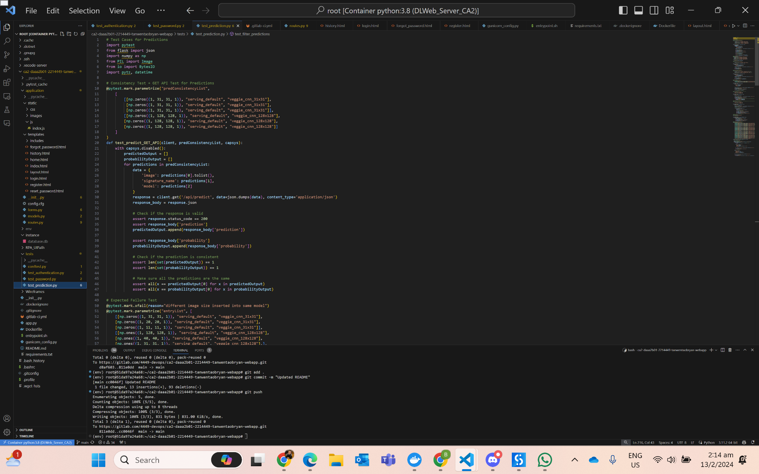
Consistency Testing
Test if predictions and probabilities of both model are consistent
Predict API + GET API
Check consistency of application behaviour
Data is grouped into 3 arrays and looped into the ML model to predict and check if all predictions into the 3 arrays are equal
Make use of /api/predict API

Slide 19
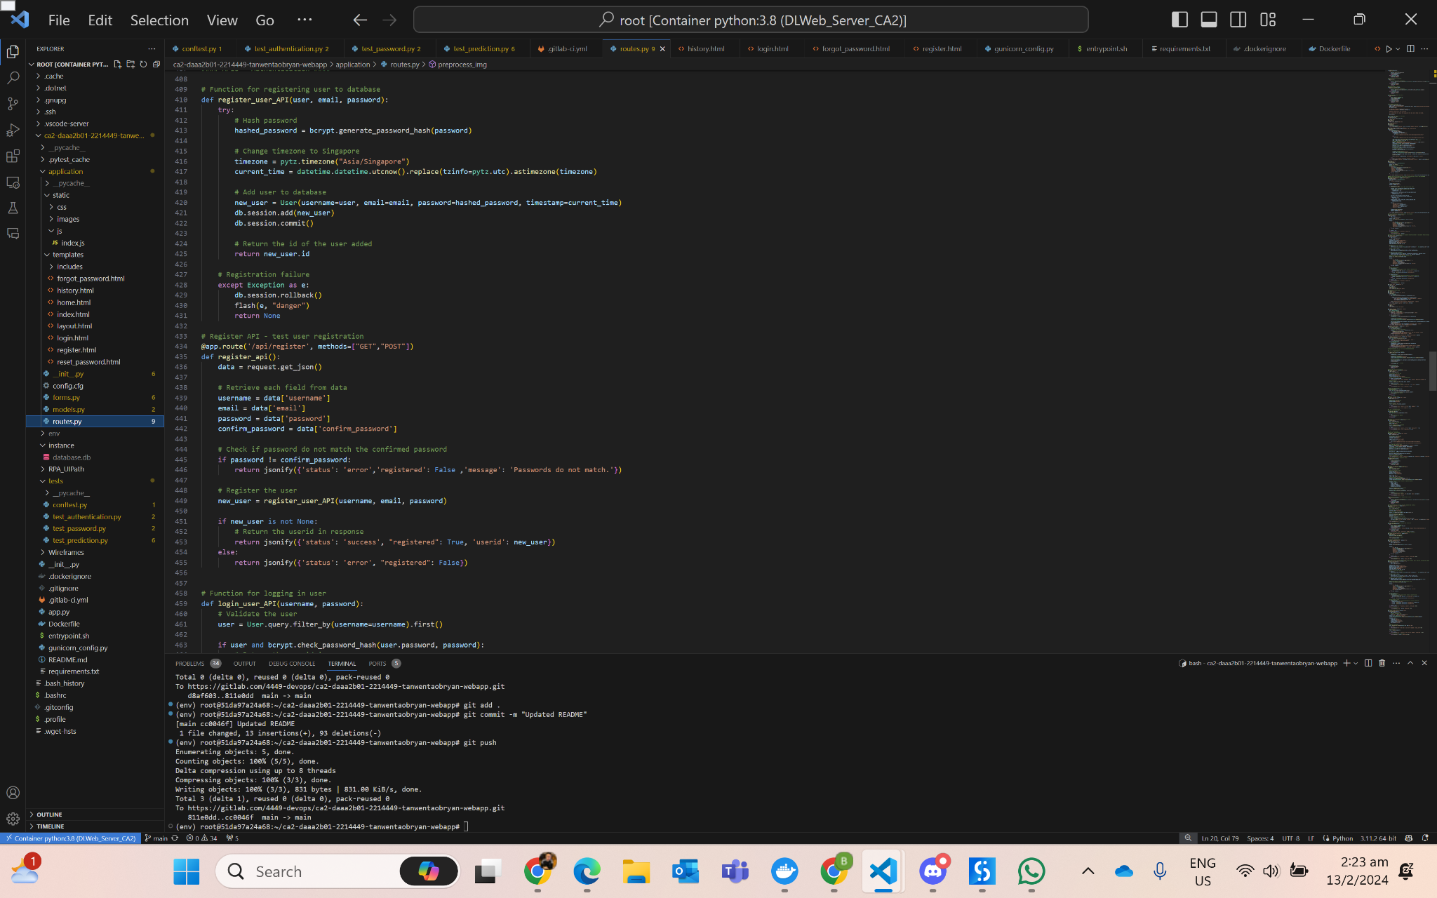
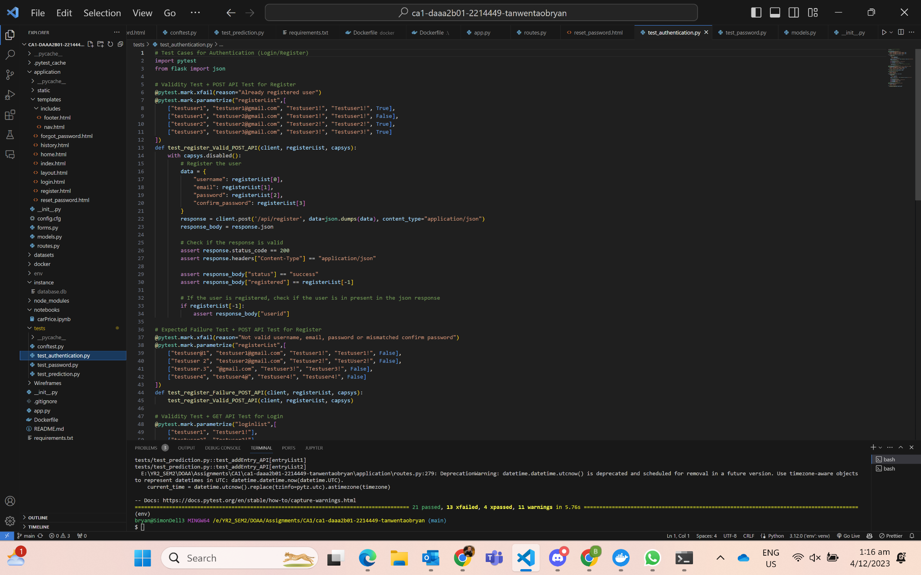
Expected Failure Testing
Verifies if application handles error or failures appropriately
Same function used as the expected failure testing, register_user_API()
Expects failures as the result

Slide 20


Validity Testing
Ensures that input data is valid and meet the expected criteria at the end
Validate the data beforehand
Make use of /api/get_entries to ensure that the entries previously added by users of the particular email, matches the results to show that the records are being fetched successfully

Slide 21


Web App Deployment
Deploy web app on render with the containerized application and dependencies
https://veggietales.onrender.com/

Slide 22




Robotic Process Automatic
Use UIPath to automate GUI testing
Registration and Login
‘Google Spreadsheet’ used to store values used to fill in the form
Store values in variables to use in the next activity
Read as cell and use ‘Type Into’ and ‘Click’ activities to ensure details are processed
Predict
Using GDrive to store images and ‘Download File’ and select the image to be uploaded into prediction

Slide 23
~THANK YOU~

